Slide 1
Understanding
Next Generation Sequencing (NGS) Technology
Robert Yu
September 2013

Slide 2
a note about the talk
Working on our recent research projects using NGS data, I realized that I have to adopt more new tool kits, to learn more new concepts, new data processing techniques and new analysis methods. And thus this presentation.
Rather than a presentation of a completed study, it is more of the notes of my ongoing learning NGS technology.
Therefore, the content listed in the subsequent slides could be improperly organized and incomplete at all. However, I hope the presentation process could further clarify myself on the learning and gather your additions and suggestions to my more effective learning process.
Thank you.

Slide 3
Outlines
Overview
DNA Sequencing
Sanger sequencing
NGS Technology
Overview
Resequencing
De novo Sequencing
NGS Data Processing
Workflow using GATK
Reads mapping → SAM/BAM files
Variants Detection → VCF files
SNP VCF
SNP and Indel Calling
SNP VCF Conversion to PLINK by PSEQ
SNP analysis
Summary
Ref:

Slide 4
Overview
Overview
Ref:

Slide 5
Overview
Conventional low resolution genotyping
e.g. microsatellite marker, low density SNP, etc.
Genomic DNA
→ dense genotyping
→ better genetic studies
Whole genome sequencing or target (regional) sequencing
Technical challenges in large-scale of DNA sequencing and post-sequencing data processing → NGS and sequencing data analyses
Ref:

Slide 6
DNA Sequencing
DNA Sequencing
Ref:

Slide 7
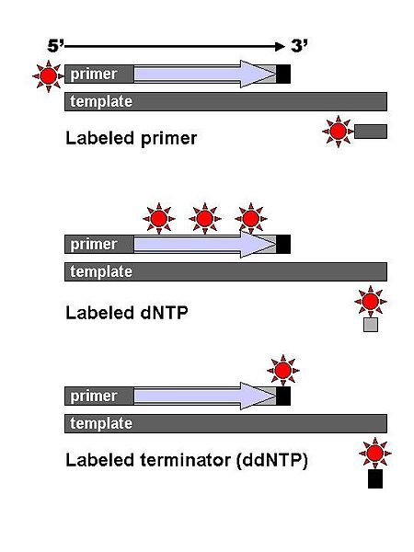
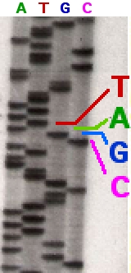
DNA Sequencing – classical chain-termination method
Conventional DNA sequencing method
The X-ray film imaging a radioactively labelled sequencing gel displaying synthesized DNA fragments in different lengths, after running electrophoresis
The classical chain-termination method requires a single-stranded DNA template, a DNA primer, a DNA polymerase, normal deoxynucleosidetriphosphates (dNTPs), and modified nucleotides (dideoxyNTPs, ddNTP) that terminate DNA strand elongation.
DNA fragments are labelled with a radioactive or fluorescent tag on the primer (1), in the new DNA strand with a labeled dNTP, or with a labeled ddNTP.
Ref: http://en.wikipedia.org/wiki/Sanger_sequencing

Slide 8
DNA Sequencing – Sanger rapid sequencing method
History of DNA sequencing technology
First sequencing effort was taken on RNA. A first bacteria RNA sequence was reported by Walter Fiers at Univ of Ghent in Belgium in 1972.
In 1970s, several notable advancements in DNA sequencing were made.
In 1977, at MRC in UK, Frederick Sanger and colleagues developed a rapid DNA sequencing method, which becomes most widely-used sequencing method for approximately 25 years.
The longer read (fragment) lengths in Sanger methods display significant advantages over other sequencing methods especially in terms of sequencing repetitive regions of the genome.
Good for de novo sequencing and in sequencing highly rearranged genome segments, e.g. cancer genome, etc.
In 2000s, “Next Generation” sequencing method invented, which allows sequencing in parallel and in large scale.
http://en.wikipedia.org/wiki/Microfluidic_Sanger_Sequencing

Slide 9
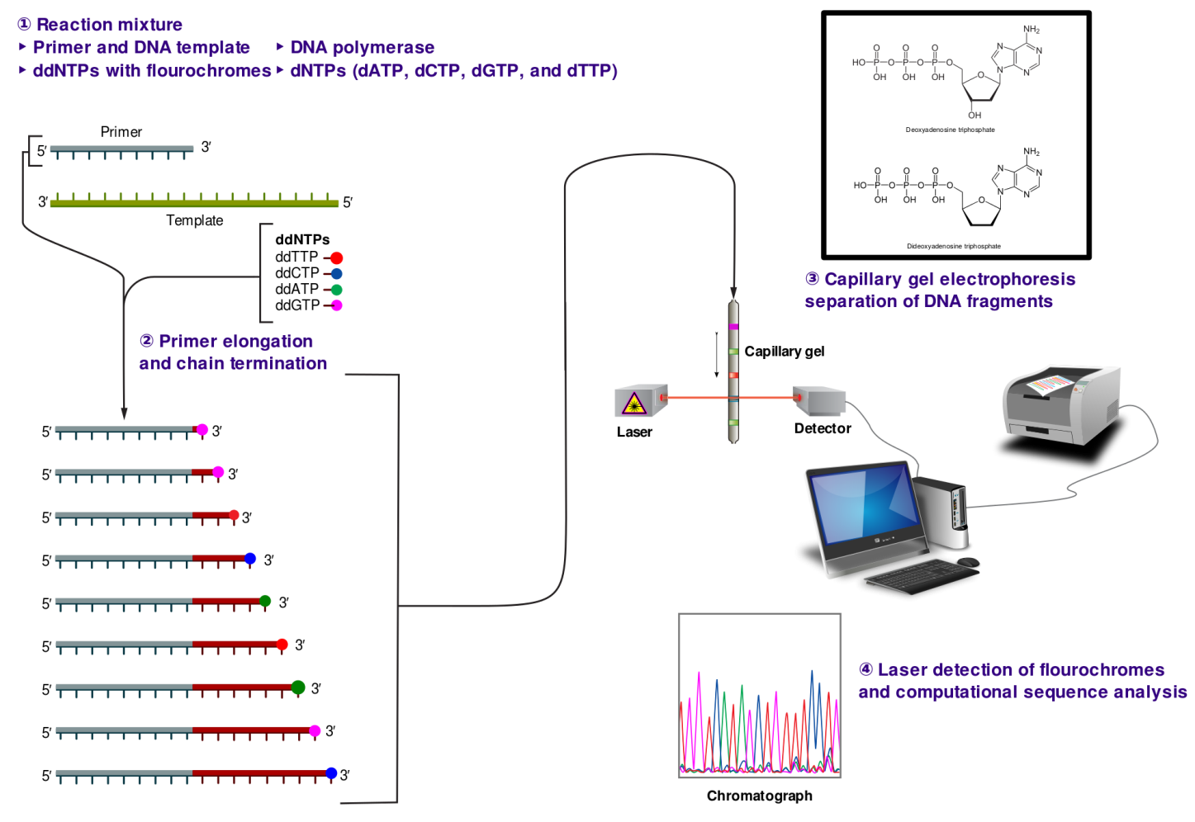
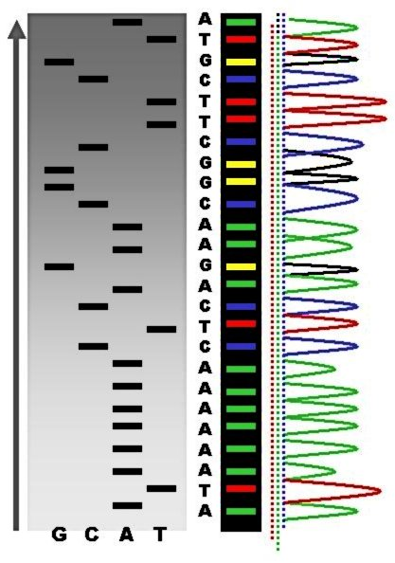
Sanger Sequencing Method
Automation of Sanger DNA sequencing
Ref: http://en.wikipedia.org/wiki/Microfluidic_Sanger_Sequencing

Slide 10
Next Generation Sequencing Technology
NGS Technology
Ref:

Slide 11
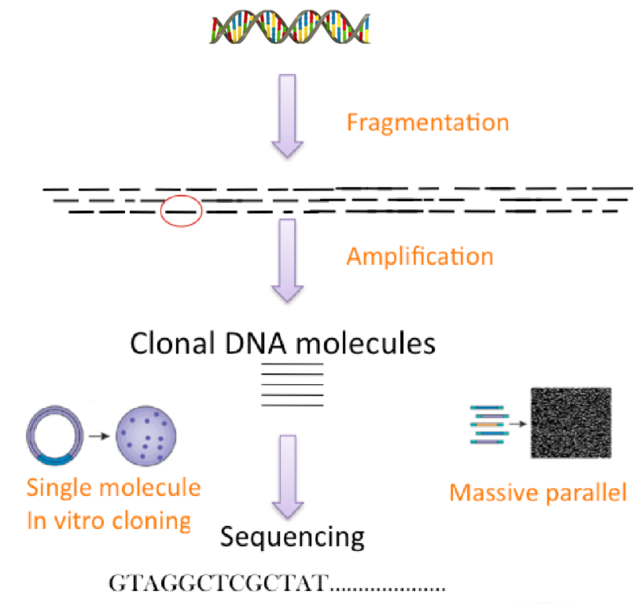
How Does Next Generation Sequencing Work?
Schematic Overview of Large-scale of DNA Sequencing
Ref: http://www.broadinstitute.org/gatk/guide/topic?name=best-practices

Slide 12
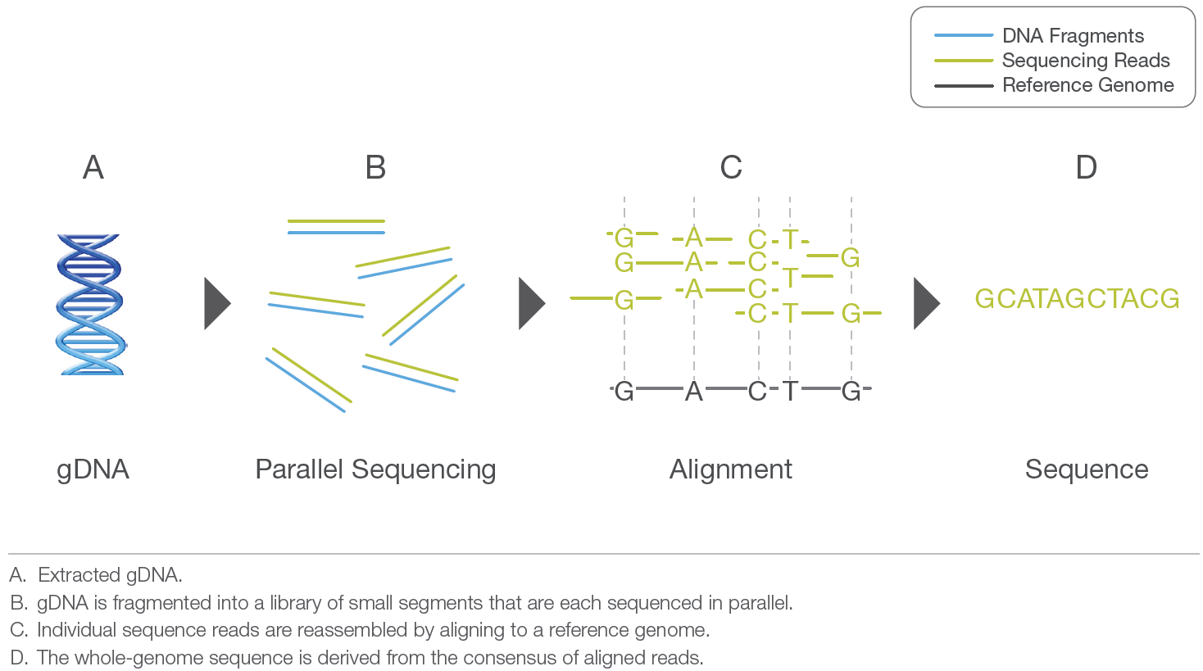
Next Generation Sequencing Technology – Illumina Approach
Commercialized NGS
The gDNA (genomic DNA) is first fragmented into a library of small segments that can be uniformly and accurately sequenced in millions of parallel reactions. The newly identified strings of bases, called reads, are then reassembled using a known reference genome as a scaffold (resequencing), or in the absence of a reference genome (de novo sequencing). The full set of aligned reads reveals the entire sequence of each chromosome in the gDNA sample.
Ref: http://res.illumina.com/documents/products/illumina_sequencing_introduction.pdf

Slide 13
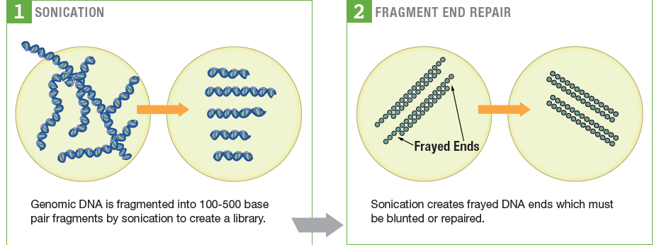
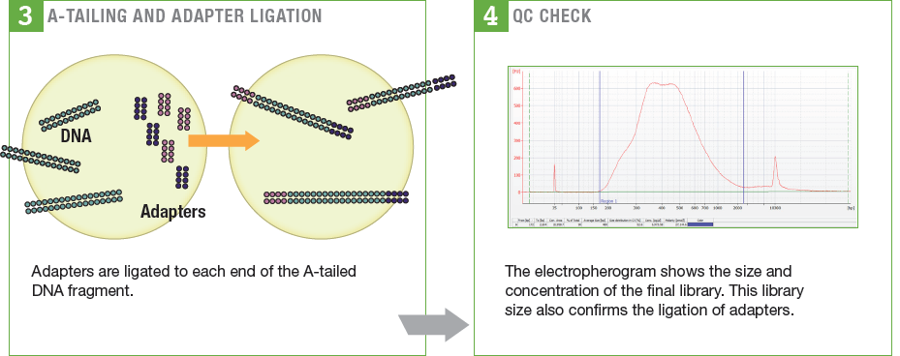
Next-Generation Sequencing Technology – Illumina Approach in details
Ref: U.S. Department of Energy Office of Science

Slide 14
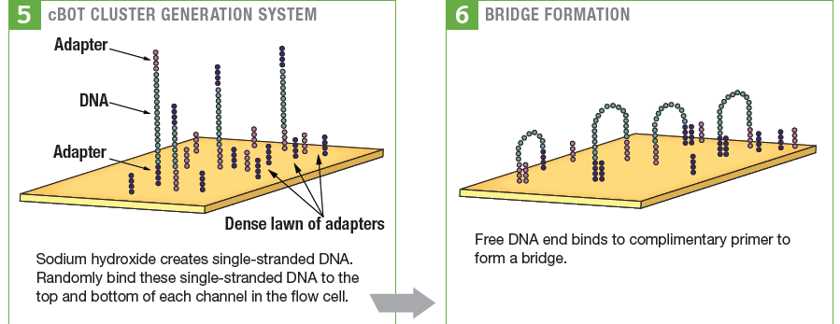
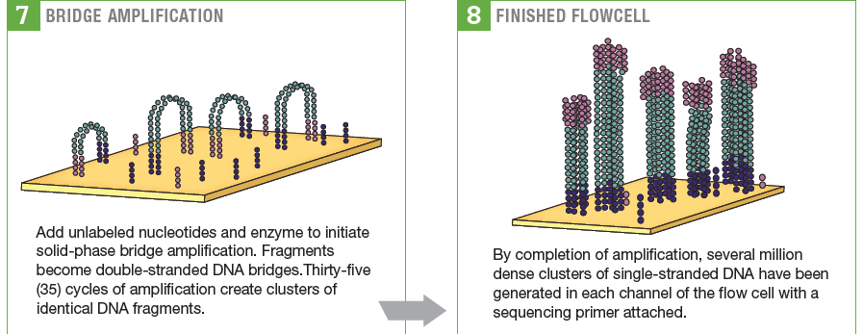
The Illumina approach
Ref: U.S. Department of Energy Office of Science

Slide 15
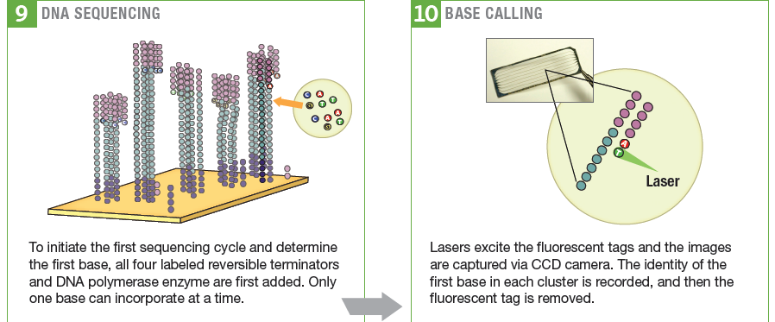
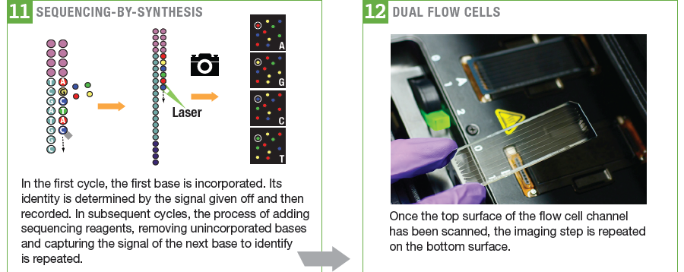
The Illumina approach
Ref: U.S. Department of Energy Office of Science

Slide 16
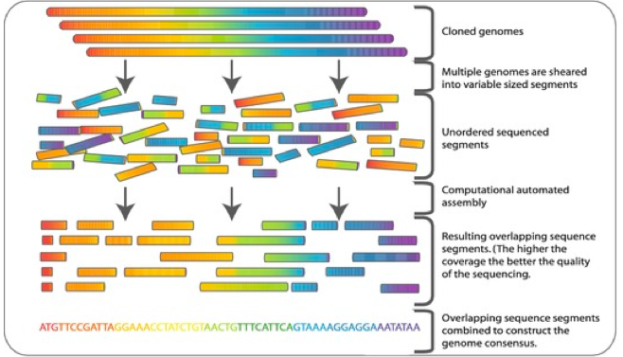
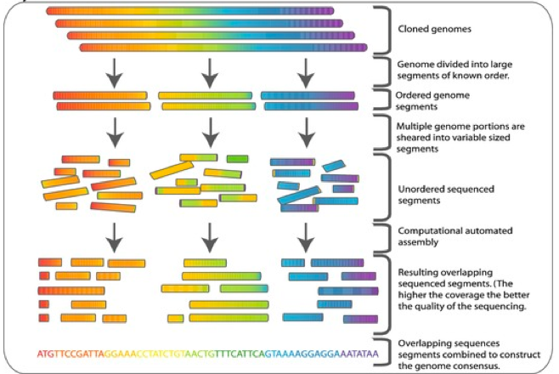
Whole genome shotgun sequencing & Hierarchical shotgun sequencing
Whole genome shotgun sequencing
The entire genome is sheared randomly into small fragments
Sequencing fragments → reads
Reassembling reads
Hierarchical shotgun sequencing
The genome is first broken into larger segments.
After the order of these segments is deduced, they are further sheared into fragments.
Sequencing fragments → reads
Reassembling reads.
Ref: http://en.wikipedia.org/wiki/Shotgun_sequencing

Slide 17
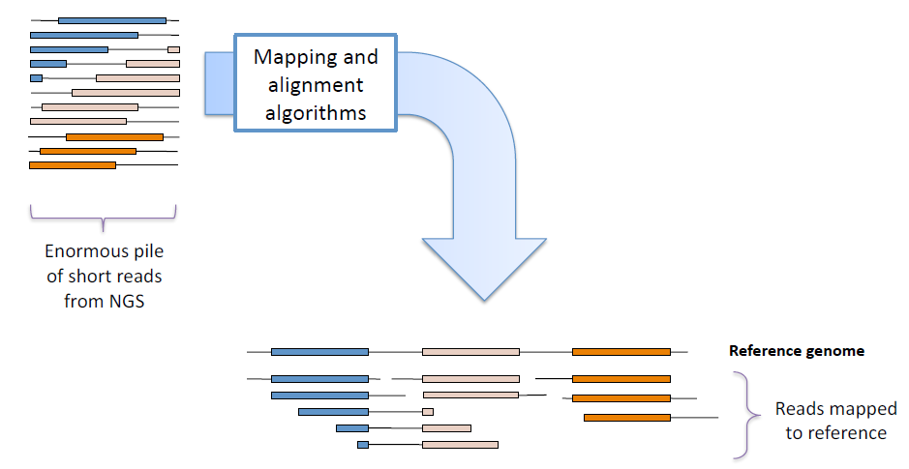
Next Generation Sequencing
Strand | Sequence
Original | AGCATGCTGCAGTCATGCTTAGGCTA
First shotgun sequence | AGCATGCTGCAGTCATGCT------- -------------------TAGGCTA
Second shotgun sequence | AGCATG-------------------- ------CTGCAGTCATGCTTAGGCTA
Reconstruction | AGCATGCTGCAGTCATGCTTAGGCTA
Ref: http://www.broadinstitute.org/gatk/guide/topic?name=best-practices

Slide 18
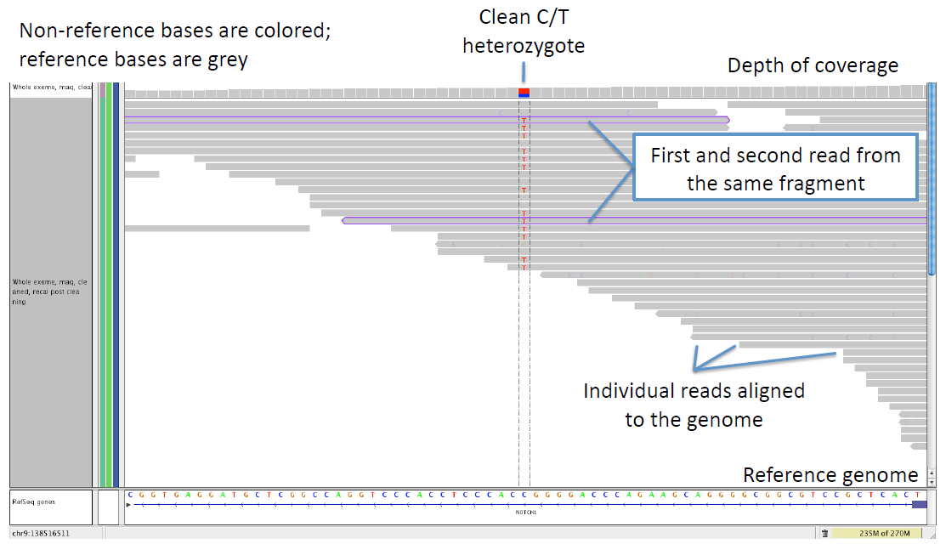
Next Generation Sequencing
Ref: http://www.broadinstitute.org/gatk/guide/topic?name=best-practices

Slide 19
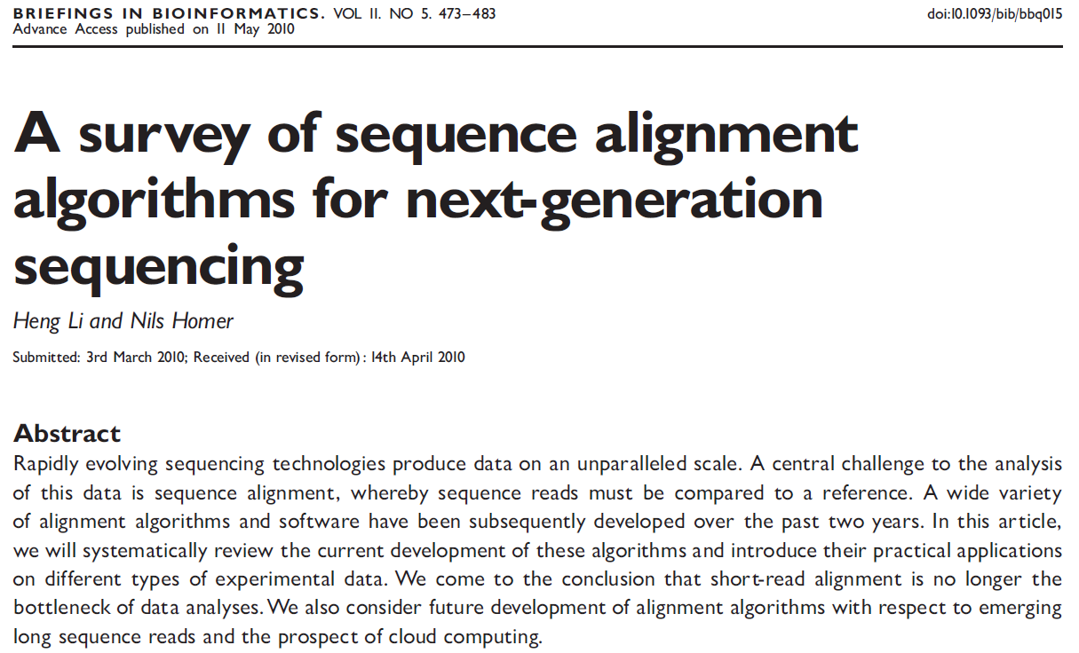
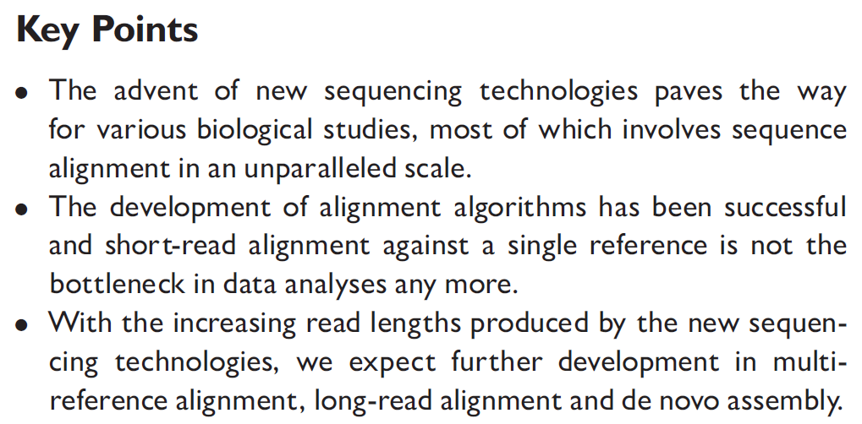
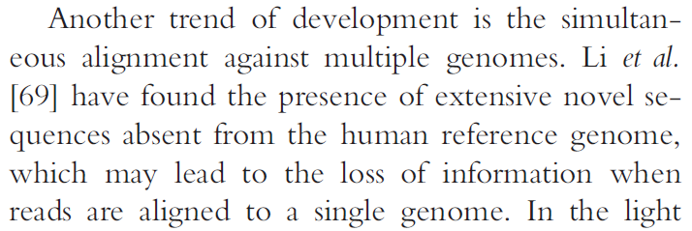
NGS sequence alignment algorithms
Ref: BRIEFINGS IN BIOINFORMATICS. VOL 11. NO 5. 473-483 (2010); Heng Li, Broad Institute, 5 Cambridge Center, Cambridge, MA 02142

Slide 20
Next Generation Sequencing
High pass
low pass
Exom Capture
Ref: http://www.broadinstitute.org/gatk/guide/topic?name=best-practices

Slide 21
Next-Generation Sequencing Technology
A sequencing run can be tailored to produce more or less data, zoom in with high resolution on particular regions of the genome, or provide a more expansive view with lower resolution.
The term coverage generally refers to the average number of sequencing reads that align to each base within the sample DNA. For example, a whole genome sequenced at 30× coverage means that, on average, each base in the genome was covered by 30 sequencing reads.
In cancer research, somatic mutations may only exist within a small proportion of cells in a given tissue sample. Using mixed-cell samples, the region of DNA harboring the mutation must be sequenced at very high levels of coverage, upwards of 1000×, to detect these low frequency mutations within the cell population.
For genome-wide variant discovery, a researcher would likely choose a much lower coverage level to sequence at lower resolution, but process larger sample numbers to achieve greater statistical power within a given population of interest.
Data Analysis Algorithms
The algorithms for sequencing data analysis differ depending on a given application.
For de novo sequencing, it requires specialized assembly of sequencing reads.
For RNA-Seq, it requires to quantify read counts to provide information about gene expression levels.
Ref: http://res.illumina.com/documents/products/illumina_sequencing_introduction.pdf

Slide 22
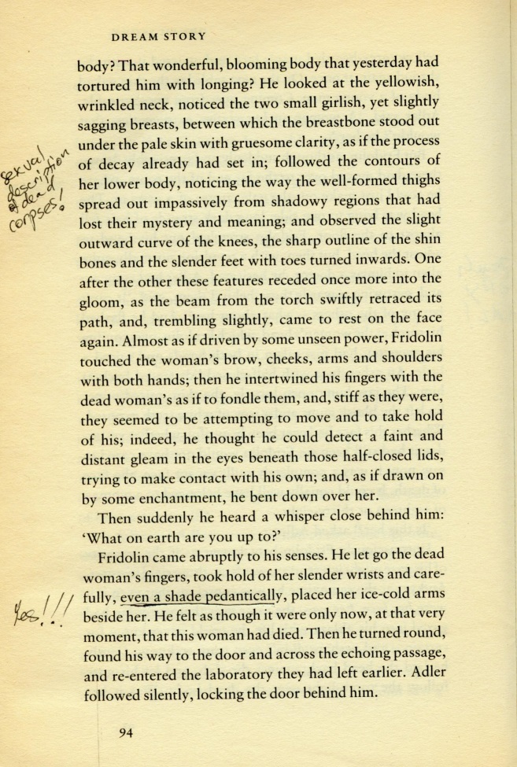
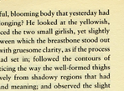
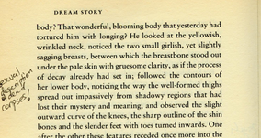
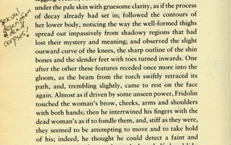
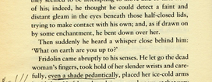
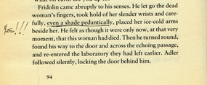
An analogy of NGS strategy

Slide 23
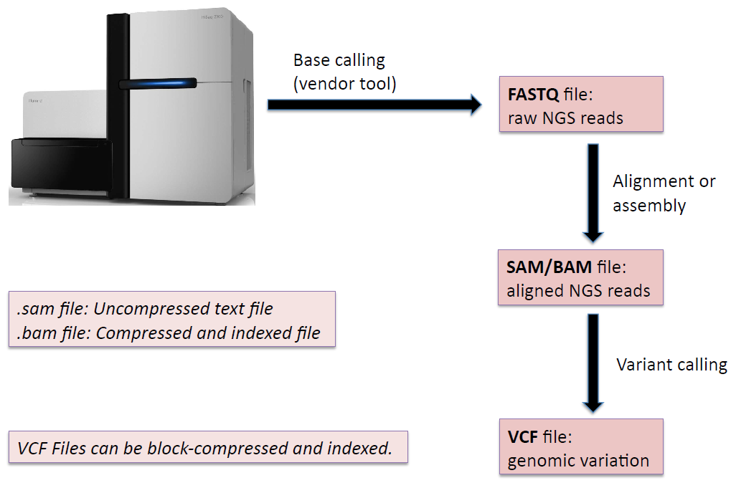
Next Generation Sequencing
Ref: http://www.broadinstitute.org/gatk/guide/topic?name=best-practices

Slide 24
NGS Data Processing
NGS Data Processing
Ref:

Slide 25
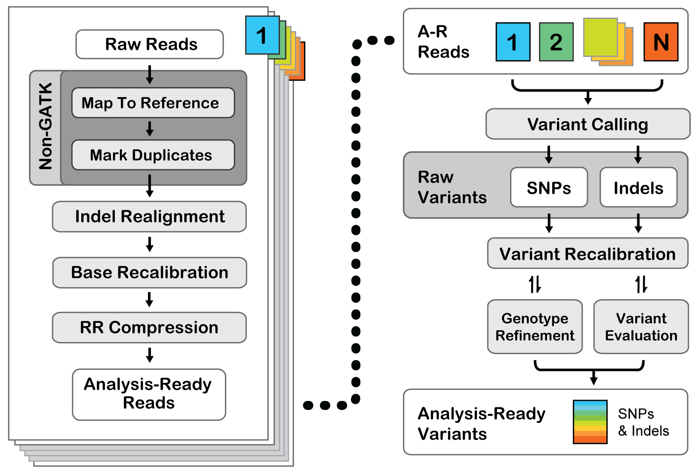
Workflow using GATK
*
* RR Compression – compress file size through reducing reads (remove redundant info)
Ref: http://www.broadinstitute.org/gatk/guide/

Slide 26
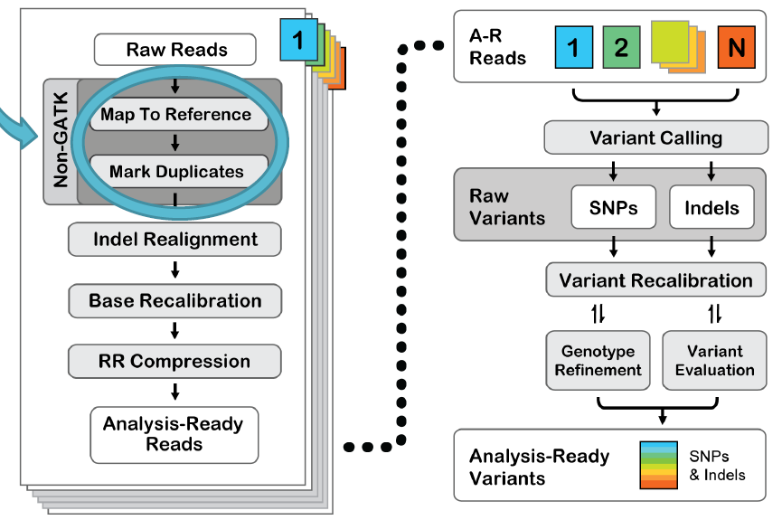
Workflow using GATK – mapping and dedupping
Ref:

Slide 27
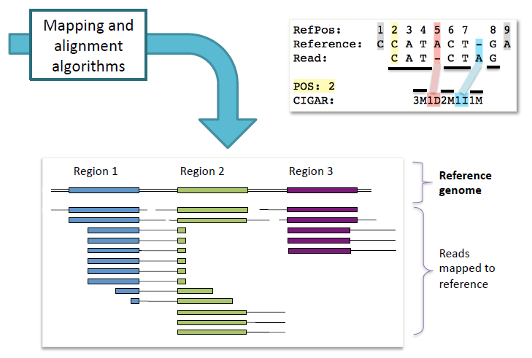
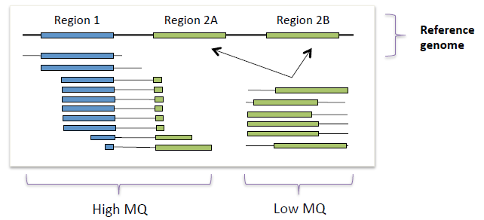
Workflow using GATK
Ref: http://www.broadinstitute.org/gatk/guide/

Slide 28
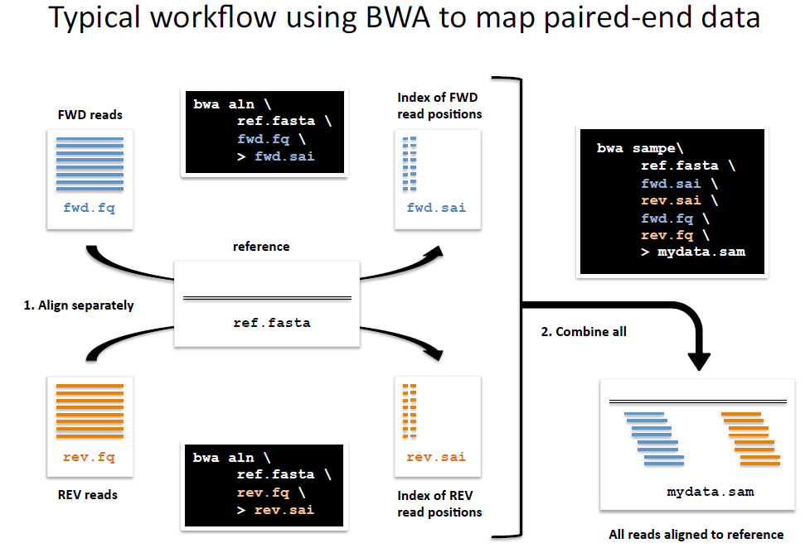
Workflow using GATK
Ref: http://www.broadinstitute.org/gatk/guide/

Slide 29
Workflow using GATK
FASTQ: raw unaligned reads from sequencer
Example
@SEQ_ID
GATTTGGGGTTCAAAGCAGTATCGATCAAATAGTAAATCCATTTGTTCAACTCACAGTTT
+
!''*((((***+))%%%++)(%%%%).1***-+*''))**55CCF>>>>>>CCCCCCC65
Line 4 encodes the quality values for the sequence in Line 2, and must contain the same number of symbols as letters in the sequence.
@HWI-EAS209_0006_FC706VJ:5:58:5894:21141#ATCACG/1 TTAATTGGTAAATAAATCTCCTAATAGCTTAGATNTTACCTTNNNNNNNNNNTAGTTTCTTGAGATTTGTTGGGGGAGACATTTTTGTGATTGCCTTGAT
+HWI-EAS209_0006_FC706VJ:5:58:5894:21141#ATCACG/1 efcfffffcfeefffcffffffddf`feed]`]_Ba_^__[[YBBBBBBBBBBRTT\]][]dddd`ddd^dddadd^BBBBBBBBBBBBBBBBBBBBBBBB
ASCII Table
Char | Dec | Char | Dec | Char | Dec | Char | Dec | Char | Dec | Char | Dec | Char | Dec | Char | Dec
(sp) | 32 | ( | 40 | 0 | 48 | 8 | 56 | @ | 64 | H | 72 | P | 80 | X | 88
! | 33 | ) | 41 | 1 | 49 | 9 | 57 | A | 65 | I | 73 | Q | 81 | Y | 89
" | 34 | * | 42 | 2 | 50 | : | 58 | B | 66 | J | 74 | R | 82 | Z | 90
# | 35 | + | 43 | 3 | 51 | ; | 59 | C | 67 | K | 75 | S | 83 | [ | 91
$ | 36 | , | 44 | 4 | 52 | < | 60 | D | 68 | L | 76 | T | 84 | \ | 92
% | 37 | - | 45 | 5 | 53 | = | 61 | E | 69 | M | 77 | U | 85 | ] | 93
& | 38 | . | 46 | 6 | 54 | > | 62 | F | 70 | N | 78 | V | 86 | ^ | 94
' | 39 | / | 47 | 7 | 55 | ? | 63 | G | 71 | O | 79 | W | 87 | _ | 95
Ref: http://www.broadinstitute.org/gatk/guide/

Slide 30
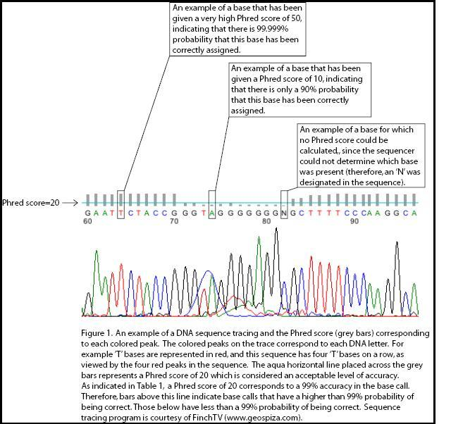
Phred Qaulity Score
Phred Quality Score Q | Probability of incorrect base call P | Base call accuracy %
10 | 1 in 10 | 90%
20 | 1 in 100 | 99%
30 | 1 in 1000 | 99.9%
40 | 1 in 10000 | 99.99%
50 | 1 in 100000 | 99.999%
Ref: http://en.wikipedia.org/wiki/Phred_quality_score

Slide 31
Glossary – Phred Quality Score
Phred base-calling is a computer program for identifying a base (nucleobase) sequence from a fluorescence "trace" data generated by an automated DNA sequencer that uses electrophoresis and 4-fluorescent dye method.
Phred was originally conceived in the early 1990s by Phil Green, then a professor at Washington University in St. Louis. “Phred reads DNA sequencer trace data, calls bases, assigns quality values to the bases, and writes the base calls and quality values to output files.”– from Phred (version 0.020425.c) documentation by Phil Green
Phred uses a four-phase procedure as outlined by Ewing et al. to determine a sequence of base calls from the processed DNA sequence tracing:
Predicted peak locations are determined, based on the assumption that fragments are relatively evenly spaced, on average, in most regions of the gel, to determine the correct number of bases and their idealized evenly spaced locations in regions where the peaks are not well resolved, noisy, or displaced (as in compressions)
Observed peaks are identified in the trace
Observed peaks are matched to the predicted peak locations, omitting some peaks and splitting others; as each observed peak comes from a specific array and is thus associated with 1 of the 4 bases (A, G, T, or C), the ordered list of matched observed peaks determines a base sequence for the trace.
The unmatched observed peaks are checked for any peak that appears to represent a base but could not be assigned to a predicted peak in the third phase and if found, the corresponding base is inserted into the read sequence.
The entire procedure is rapid, usually taking less than half a second per trace.
Ref: http://en.wikipedia.org/wiki/Phred_base_calling

Slide 32
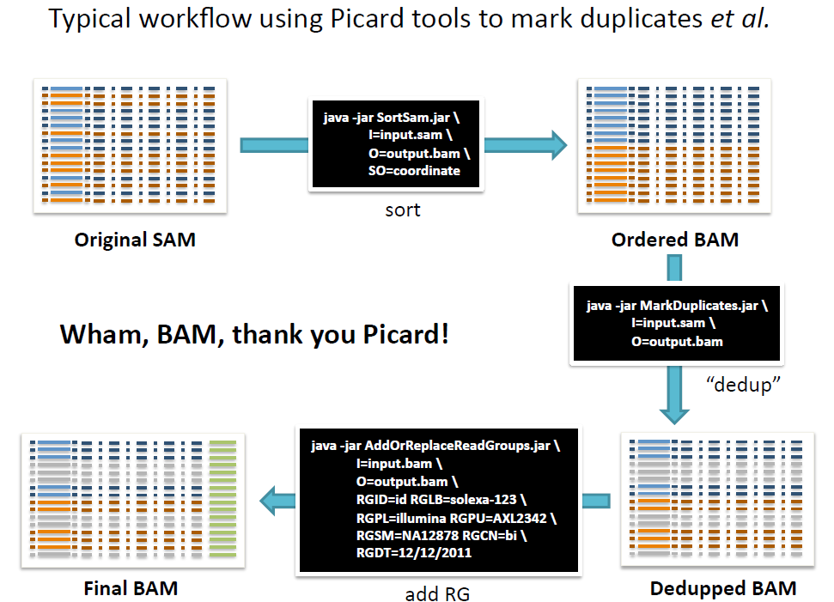
Workflow using GATK: mapping and duplicate marking
Ref: http://www.broadinstitute.org/gatk/guide/

Slide 33
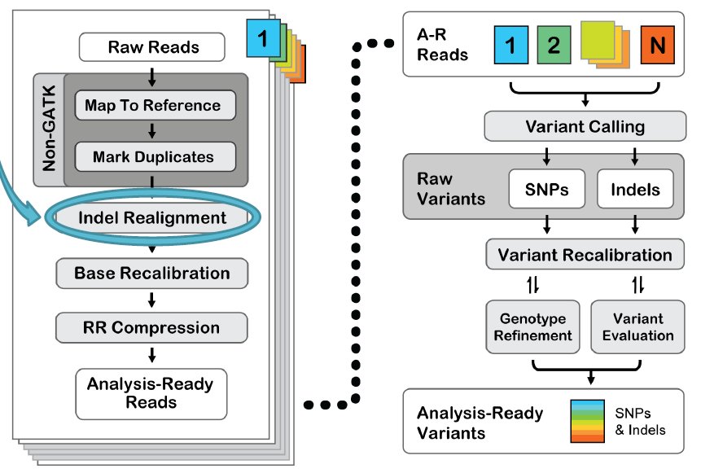
Workflow using GATK – realignment
Ref:

Slide 34
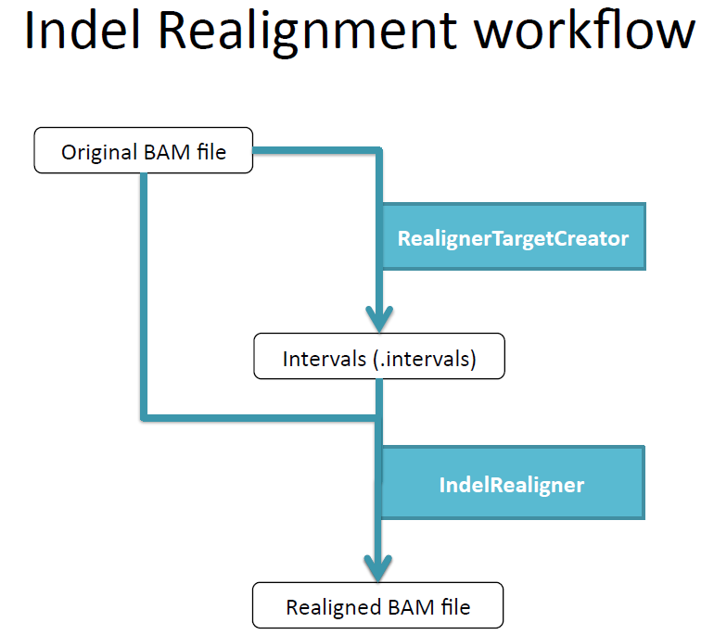
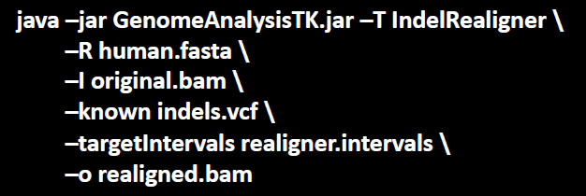
Workflow using GATK: indel-based realignment
Ref: http://www.broadinstitute.org/gatk/guide/

Slide 35
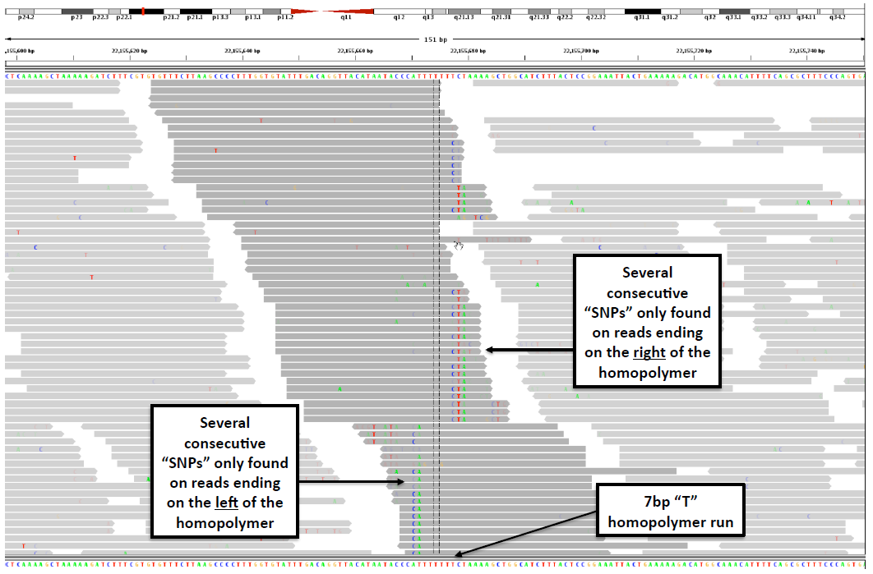
Workflow using GATK: indel-based realignment
Ref: http://www.broadinstitute.org/gatk/guide/

Slide 36
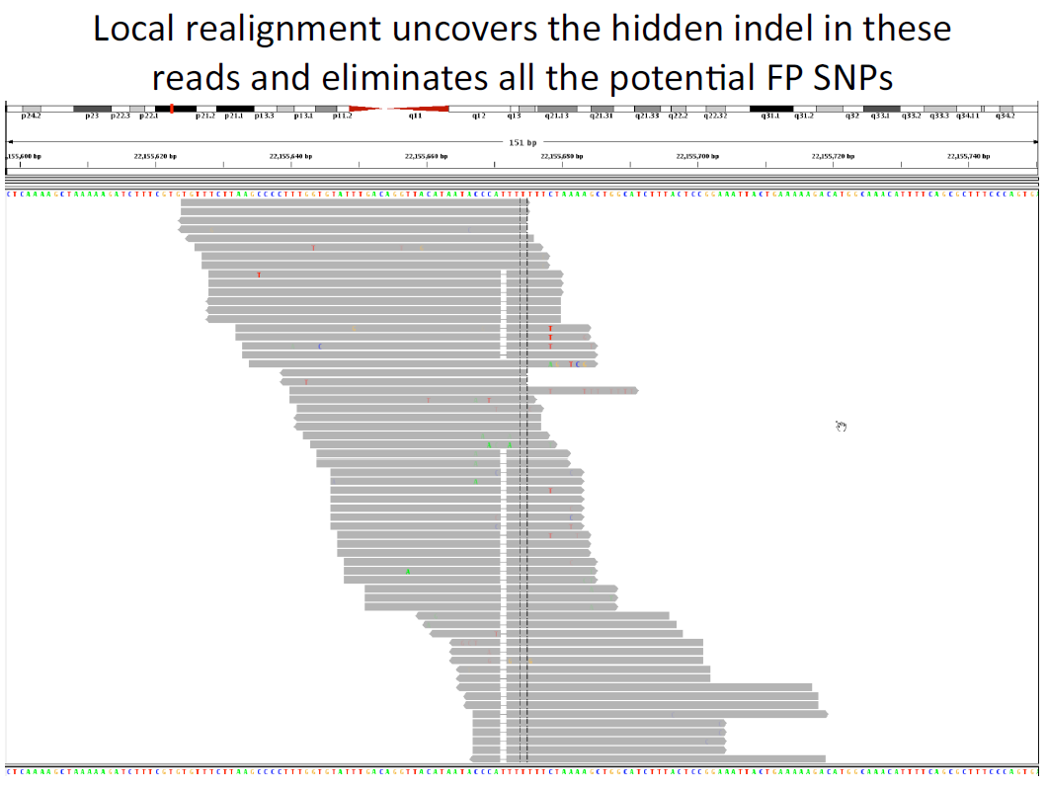
Workflow using GATK: indel-based realignment
Ref: http://www.broadinstitute.org/gatk/guide/

Slide 37
Workflow using GATK: indel-based realignment
Ref: http://www.broadinstitute.org/gatk/guide/

Slide 38
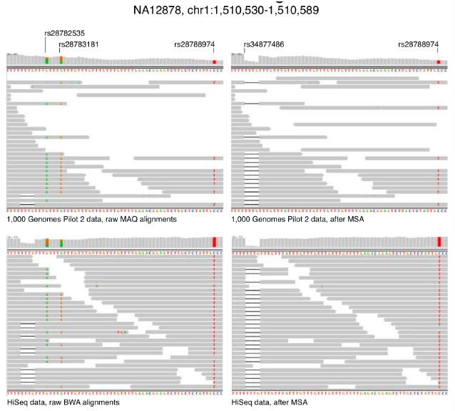
Workflow using GATK: indel-based realignment
Ref: http://www.broadinstitute.org/gatk/guide/

Slide 39
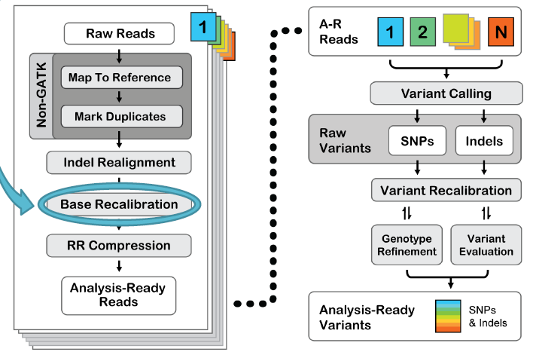
Workflow using GATK – base recalibration
Ref:

Slide 40
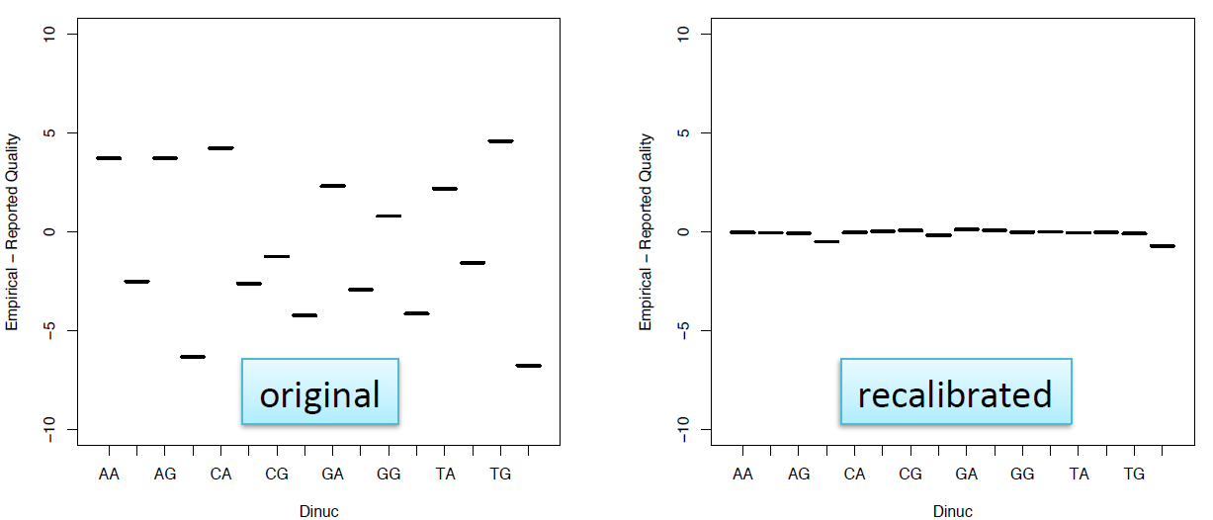
Workflow using GATK: Base Quality Score Recalibration
Quality scores are critical for all downstream analysis
Systematic biases are a major contributor to bad calls
The quality scores issued by sequencers are inaccurate and biased
Analyze covariates among several features of a base, e.g.:
Reported quality score
Position within the read (machine cycle)
Preceding and current nucleotide (sequencing chemistry effect)
Apply covariates through a piecewise tabular correction to recalibrate the quality scores of all reads in a BAM file.
Ref: http://www.broadinstitute.org/gatk/guide/

Slide 41
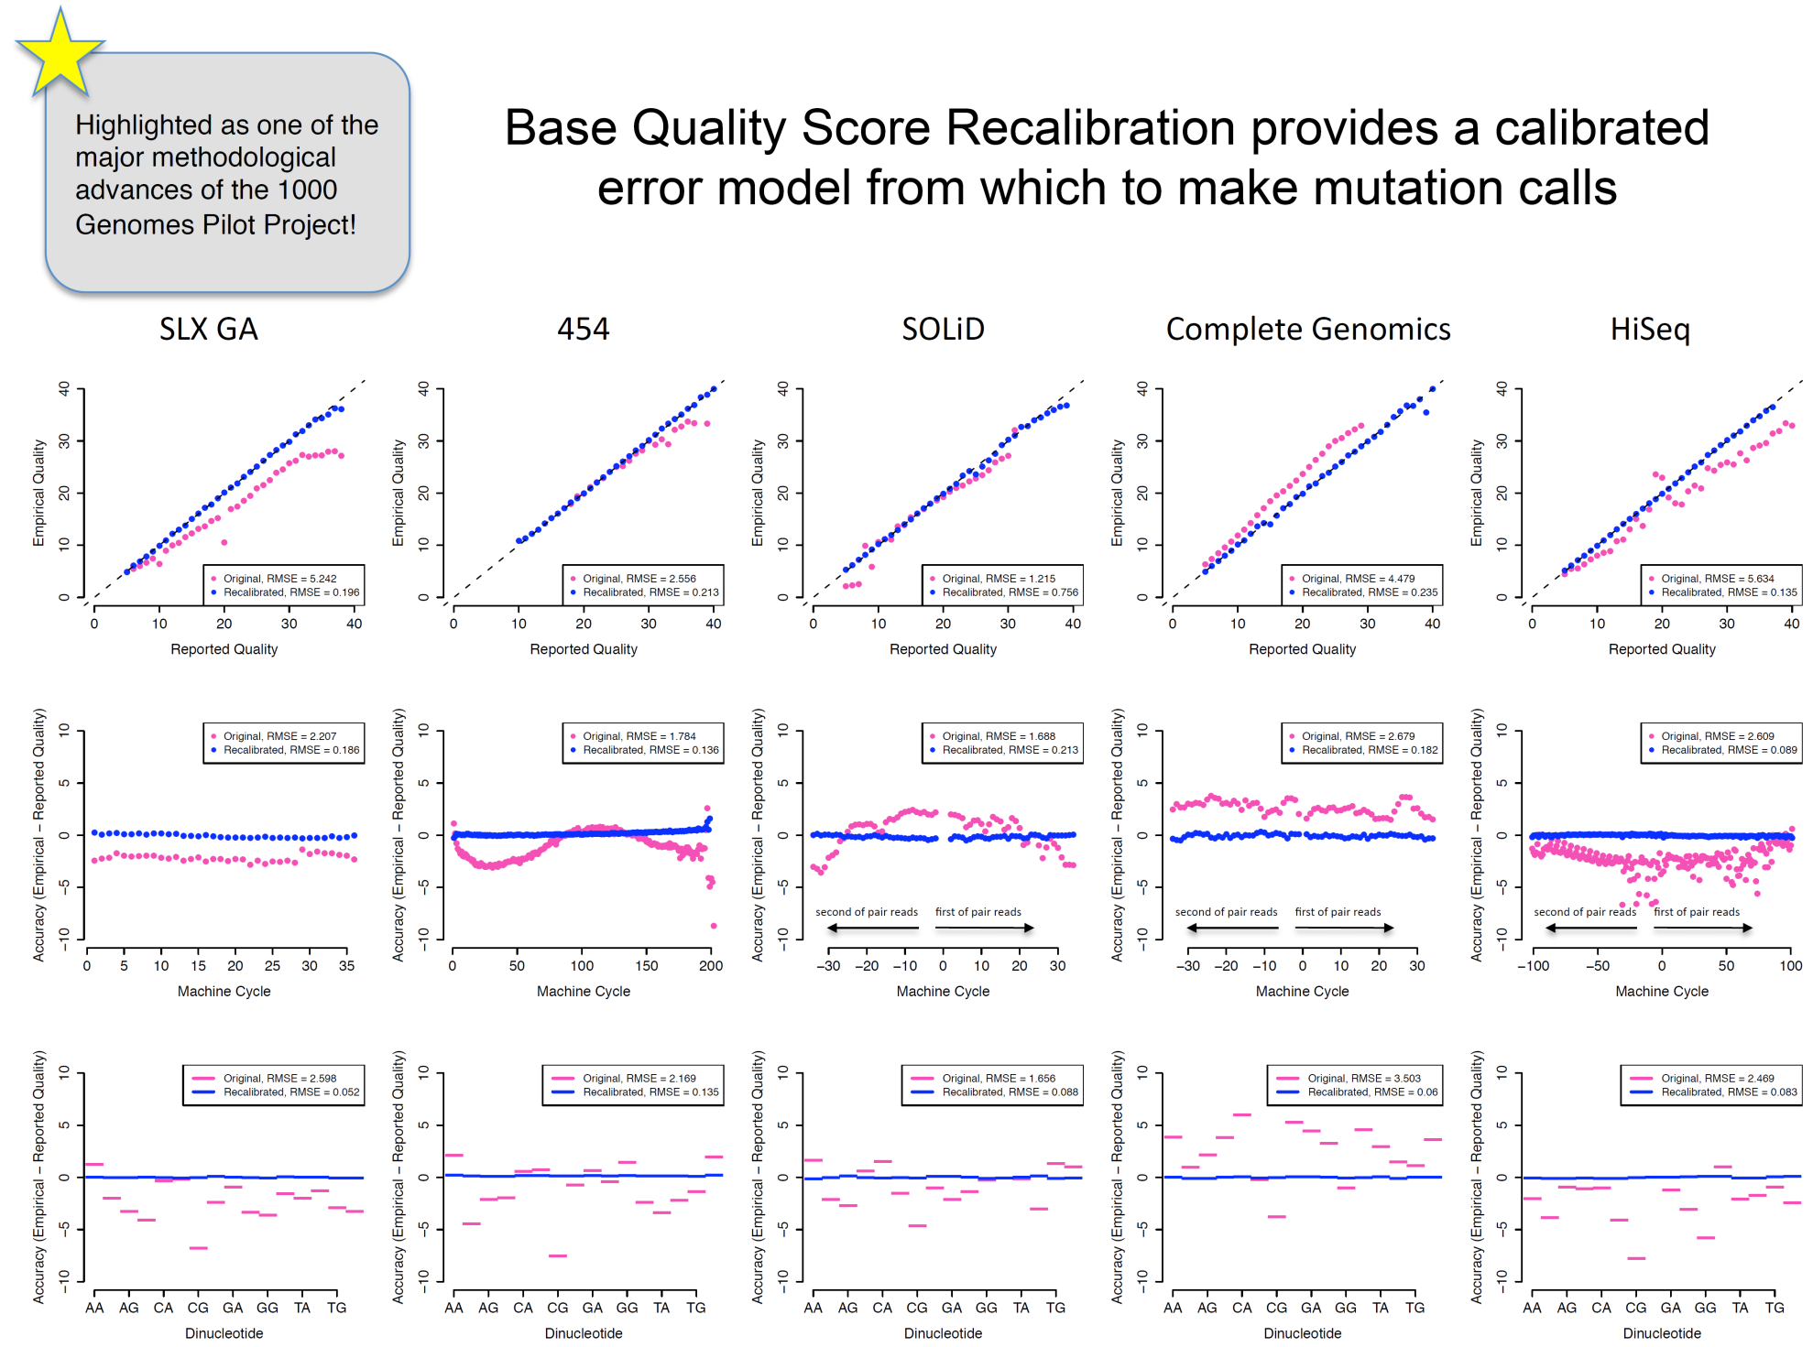
Workflow using GATK: Base Quality Score Recalibration
Ref: http://www.broadinstitute.org/gatk/guide/

Slide 42
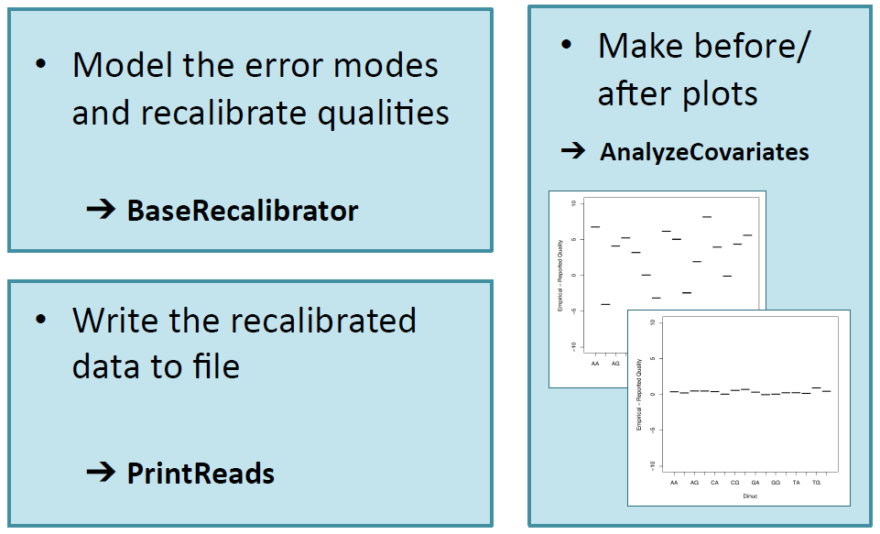
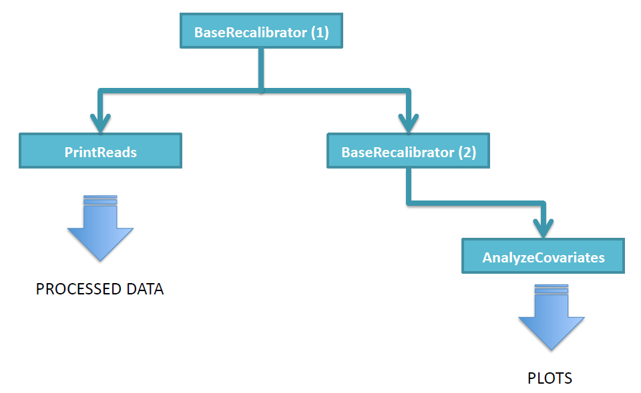
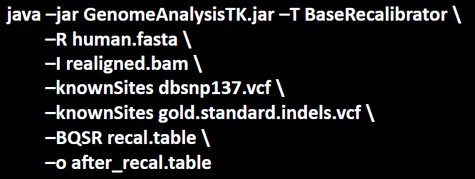
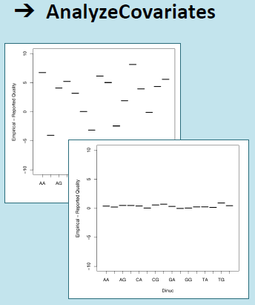
Workflow using GATK: Base Quality Score Recalibration
Base Recalibration steps / tools
1st pass
Output file
2nd pass
Before/after plot
Ref: http://www.broadinstitute.org/gatk/guide/

Slide 43
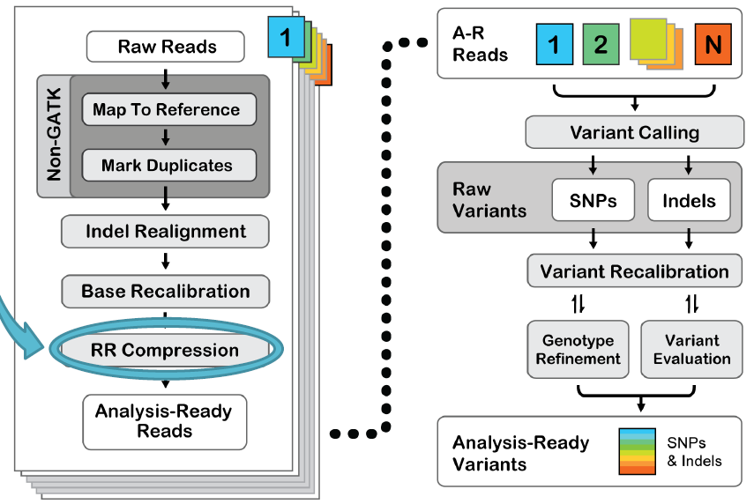
Workflow using GATK – Reduce Reads (compression)
Ref:

Slide 44
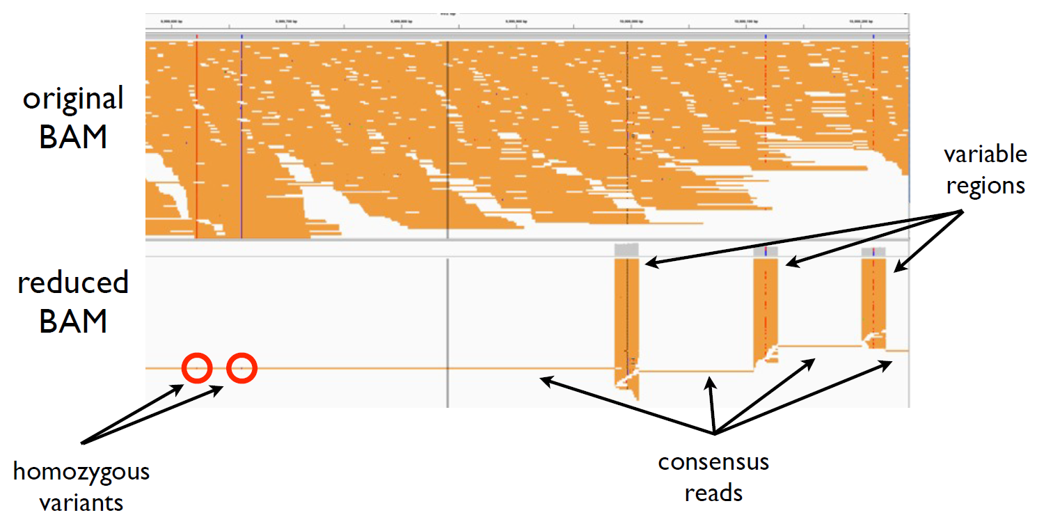
Workflow using GATK: Data Compression with Reduce Reads
The size of the BAM file is a major roadblock for data analysis scalability
Huge size of a BAM file makes file transfer impractical, simple analysis time-consuming, and complex analysis non-viable.
Data compression is to throw out redundant information
Ref: http://www.broadinstitute.org/gatk/guide/

Slide 45
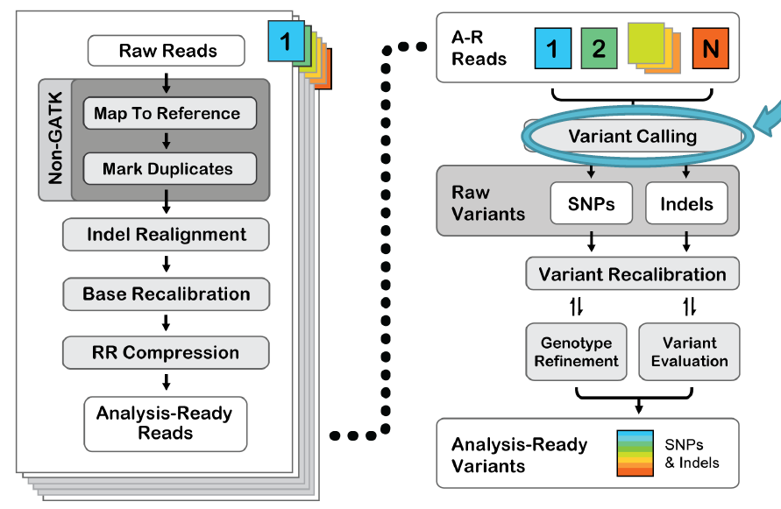
Workflow using GATK – Calling Variants
Ref:

Slide 46
Genotype and SNP calling
DNA Library Preparation
The library is a mixture of both ancestral chromosomes of a pair, and thus the DNAs – diploids.
genotype / SNP calling
Ref
read 1
read 2
read 3
read 4
A
C
A
C
T
Ref: Elaine R. Mardis, “Next-Generation DNA Sequencing Methods”, Annu. Rev. Genomics Hum. Genet. 2008.9:387–402

Slide 47
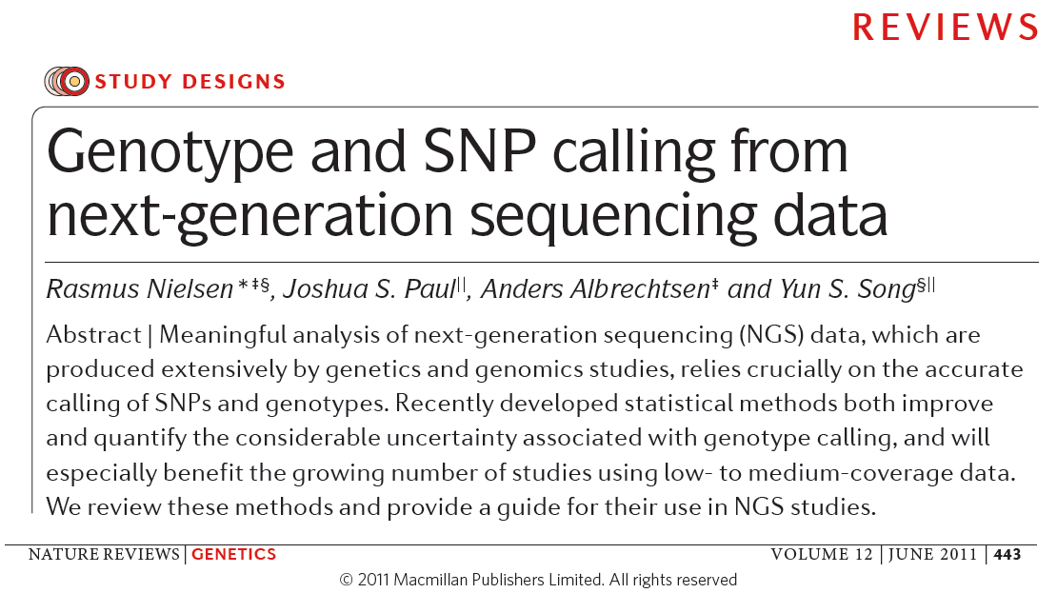
Genotype and SNP calling
Ref: Elaine R. Mardis, “Next-Generation DNA Sequencing Methods”, Annu. Rev. Genomics Hum. Genet. 2008.9:387–402

Slide 48
Genotype and SNP calling
Base call + Quality score → genotype takes two steps:
Genotype calling
SNP calling
“Genotype and SNP calling is done by counting alleles at each site and using simple cutoff rules for when to call a SNP or genotype.”
Call Methods:
Early methods for calling genotypes – Filtering by Phred-type quality score, Q20, and then counting observed alleles: if non-ref allele is between 20%-80% → heterozygote, otherwise → homozygous. Needs to be 20x sequencing depth.
Probabilistic methods (for low-moderate sequencing depth) → computing likelihood, p(X|G), where G=genotype, X=all of the read data. Using a genotype prior, p(G), → the posterior probability of genotype G, p(G|X).
- the highest p(G|X) be chosen
- the ratio of the highest and the 2nd highest p(G|X) as a
measurement of confidence
Ref:Rasmus Nielsen, et al. “Genotype and SNP calling from next-generation sequencing data”, NATURE GENETICS (2011)

Slide 49
Genotype and SNP calling
Assigning priors using multiple samples Incorporating LD information
Ref:Rasmus Nielsen, et al. “Genotype and SNP calling from next-generation sequencing data”, NATURE GENETICS (2011)

Slide 50
Genotype and SNP calling
Kim S. Y. et al. Design of association studies with pooled or un-pooled next-generation sequencing data. Genet. Epidemiol. 34, 479–491 (2010).
Martin, E. R. et al. SeqEM: an adaptive genotype-calling approach for next- generation sequencing studies. Bioinformatics 26, 2803–2810 (2010).
Ref:Rasmus Nielsen, et al. “Genotype and SNP calling from next-generation sequencing data”, NATURE GENETICS (2011)

Slide 51
Genotype and SNP calling
Example line in a VCF file
Ref: GATK guide

Slide 52
Genotype and SNP calling
Example
Ref: GATK guide

Slide 53
Genotype and SNP calling
Example of a SNP.vcf – header
Ref:Atlas-SNP2

Slide 54
Genotype and SNP calling
Example of a SNP.vcf
Ref:Atlas-SNP2

Slide 55
Workflow using GATK: Calling Variants
Genetic variant or random machine noise?
→ large scale Bayesian inference problem
There are two approaches:
Initial approach: very fast, independent base assumption
Evolved approach: more computationally intensive, involves local de-novo assembly of the variable region
Variant calling tools:
Ref: http://www.broadinstitute.org/gatk/guide/

Slide 56
Workflow using GATK: Calling Variants
Ref: http://www.broadinstitute.org/gatk/guide/

Slide 57
Workflow using GATK: Calling Variants
Ref: http://www.broadinstitute.org/gatk/guide/

Slide 58
Workflow using GATK: Calling Variants
Ref: http://www.broadinstitute.org/gatk/guide/

Slide 59
Workflow using GATK: Calling Variants
Ref: http://www.broadinstitute.org/gatk/guide/

Slide 60
Workflow using GATK: Calling Variants
Ref: http://www.broadinstitute.org/gatk/guide/

Slide 61
Mapping Reads and Mapping Multireads
A key step in NGS applications (e.g., RNA-Seq) is to map short reads to correct genomic locations within the source genome.
most mappable short reads (>75%) based on available methods (e.g., Bowtie) align to a single genomic location with relatively high precision.
a significant number of reads are mapped to more than one genomic location with similar fidelity, and these reads are called multireads.
multireads disproportionally come from the genes with similar sequences (e.g., duplicated genes) and essentially determine their expression levels.
Ref: Biometrics, December 2011,

Slide 62
Workflow using GATK - example
Let's say we have this example data:
sample1_lane1.fq
sample1_lane2.fq
sample2_lane1.fq
sample2_lane2.fq
1. Run all core steps per-lane once
Assuming one FASTQ file per lane of sequence data, just run each file through each pre-processing step individually: map & dedup -> realign -> recal. The example data becomes:
sample1_lane1.dedup.realn.recal.bam
sample1_lane2.dedup.realn.recal.bam
sample2_lane1.dedup.realn.recal.bam
sample2_lane2.dedup.realn.recal.bam
2. Merge lanes per sample
Once you have pre-processed each lane individually, you merge lanes belonging to the same sample into a single BAM file. The example data becomes:
sample1.merged.bam
sample2.merged.bam
3. Per-sample refinement
You can increase the quality of your results by performing an extra round of dedupping and realignment, this time at the sample level. It is not absolutely required and will increase your computational costs, so it's up to you to decide whether you want to do it on your data, but that's how we do it internally at Broad.
Ref: http://www.broadinstitute.org/gatk/guide/tagged?tag=best-practices

Slide 63
DNA Sequencing and Mathematical Covering Problem
Sequencing as a covering problem
DNA sequencing rely on reading small fragments of DNA and subsequently reconstructing these data to infer the original DNA target, either via assembly or alignment to a reference.
How many small fragments of DNA are needed to cover the entire target region of a genome?
Elementary probability theory
The probability of “covering” any given location on the target with one particular fragment is L/G, where L=fragment length and G=target length.
The probability P that the location is covered by at least one of N fragments is
$$P=1−{\left[1−\frac{L}{G}\right]}^{N}$$
when N>>1, it can be approximately expressed as
$${\left[1−\frac{L}{G}\right]}^{N}\sim exp⁡(−NL/G)$$
where R=NL/G is called the redundancy, or “coverage”.
Lander-Waterman theory
Eric Lander and Michael Waterman in 1988 published a paper examining the covering problem from the standpoint of gaps. The main goal of a sequencing project is to close all gaps.
$$E\left\langle \#contigs\right\rangle =Ne^{−R}$$
Contig: a succession of overlapping reads,
Gaps: regions not covered by any read
Ref: “DNA sequencing theory”, http://en.wikipedia.org/wiki/DNA_sequencing_theory

Slide 64
VCF to PLINK format
VCF → PLINK format using PSEQ
Ref:

Slide 65
Workflow using PSEQ
… focus … [on] large-scale resequencing and genotyping projects … independent of (but designed to be complementary to) …PLINK package.
… to perform a range of basic, large-scale analyses … purely on analysis of genotyping/phenotype data …
Ref: http://atgu.mgh.harvard.edu/plinkseq/output.shtml

Slide 66
Workflow using PSEQ – creating PLINK files from VCF files
Create a PSEQ project
pseq proj_name new-project
Import VCF file into the project
pseq proj_name load-vcf --vcf data/*.vcf
Convert to PLINK
pseq proj_name write-ped --name mydata
Output: mydata.tped, mydata.tfam
PLINK processing
plink --tfile mydata
Ref: http://www.broadinstitute.org/gatk/guide/tagged?tag=best-practices

Slide 67
Glossary
Glossary
Ref:

Slide 68
Glossary
Phred quality scores were originally developed by the program Phred to help in the automation of DNA sequencing in the Human Genome Project. Phred quality scores are assigned to each nucleotide base call in automated sequencer traces. Phred quality scores have become widely accepted to characterize the quality of DNA sequences, and can be used to compare the efficacy of different sequencing methods. The Phred quality scores are widely used in standard Sanger format adopted in Illumina’s pipeline CASAVA.
Phred first calculates several parameters related to peak shape and peak resolution at each base.
Phred then uses these parameters to look up a corresponding quality score in huge lookup tables.
These lookup tables were generated from sequence traces where the correct sequence was known, and are hard coded in Phred; different lookup tables are used for different sequencing chemistries and machines.
An evaluation of the accuracy of Phred quality scores for a number of variations in sequencing chemistry and instrumentation showed that Phred quality scores are highly accurate
Sanger format can encode a Phred quality score from 0 to 93 using ASCII 33 to 126 (although in raw read data the Phred quality score rarely exceeds 60, higher scores are possible in assemblies or read maps). Also used in SAM format. Coming to the end of February 2011, Illumina's newest version (1.8) of their pipeline CASAVA will directly produce fastq in Sanger format, according to the announcement on seqanswers.com forum.
Phred quality scores Q are defined as a property which is logarithmically related to the base-calling error probabilities P.
$$Q=−10 \log_{10}P$$
or
$$P={10}^{\frac{−Q}{10}}$$
Ref: http://en.wikipedia.org/wiki/Phred_quality_score

Slide 69
Glossary
FASTQ format is a text-based format for storing both a biological sequence (usually nucleotide sequence) and its corresponding quality scores. Both the sequence letter and quality score are encoded with a single ASCII character for brevity. It was originally developed at the Wellcome Trust Sanger Institute to bundle a FASTA sequence and its quality data, but has recently become the de facto standard for storing the output of high throughput sequencing instruments such as the Illumina Genome Analyzer.
Example
@SEQ_ID
GATTTGGGGTTCAAAGCAGTATCGATCAAATAGTAAATCCATTTGTTCAACTCACAGTTT
+
!''*((((***+))%%%++)(%%%%).1***-+*''))**55CCF>>>>>>CCCCCCC65
Line 1 begins with a '@' character and is followed by a sequence identifier and an optional description (like a FASTA title line).
Line 2 is the raw sequence letters.
Line 3 begins with a '+' character and is optionally followed by the same sequence identifier (and any description) again.
Line 4 encodes the quality values for the sequence in Line 2, and must contain the same number of symbols as letters in the sequence.
e.g.
@HWI-EAS209_0006_FC706VJ:5:58:5894:21141#ATCACG/1 TTAATTGGTAAATAAATCTCCTAATAGCTTAGATNTTACCTTNNNNNNNNNNTAGTTTCTTGAGATTTGTTGGGGGAGACATTTTTGTGATTGCCTTGAT
+HWI-EAS209_0006_FC706VJ:5:58:5894:21141#ATCACG/1 efcfffffcfeefffcffffffddf`feed]`]_Ba_^__[[YBBBBBBBBBBRTT\]][]dddd`ddd^dddadd^BBBBBBBBBBBBBBBBBBBBBBBB
Ref: http://en.wikipedia.org/wiki/FASTQ_format

Slide 70
Glossary
Phred base-calling is a computer program for identifying a base (nucleobase) sequence from a fluorescence "trace" data generated by an automated DNA sequencer that uses electrophoresis and 4-fluorescent dye method.
Phred was originally conceived in the early 1990s by Phil Green, then a professor at Washington University in St. Louis. “Phred reads DNA sequencer trace data, calls bases, assigns quality values to the bases, and writes the base calls and quality values to output files.”– from Phred (version 0.020425.c) documentation by Phil Green
Phred uses a four-phase procedure as outlined by Ewing et al. to determine a sequence of base calls from the processed DNA sequence tracing:
Predicted peak locations are determined, based on the assumption that fragments are relatively evenly spaced, on average, in most regions of the gel, to determine the correct number of bases and their idealized evenly spaced locations in regions where the peaks are not well resolved, noisy, or displaced (as in compressions)
Observed peaks are identified in the trace
Observed peaks are matched to the predicted peak locations, omitting some peaks and splitting others; as each observed peak comes from a specific array and is thus associated with 1 of the 4 bases (A, G, T, or C), the ordered list of matched observed peaks determines a base sequence for the trace.
The unmatched observed peaks are checked for any peak that appears to represent a base but could not be assigned to a predicted peak in the third phase and if found, the corresponding base is inserted into the read sequence.
The entire procedure is rapid, usually taking less than half a second per trace.
Ref: http://en.wikipedia.org/wiki/Phred_base_calling

Slide 71
Glossary
A contig (from contiguous) is a set of overlapping DNA segments that together represent a consensus region of DNA.
In bottom-up sequencing projects, a contig refers to overlapping sequence data (reads);
In top-down sequencing projects, contig refers to the overlapping clones that form a physical map of the genome that is used to guide sequencing and assembly.
Contigs can thus refer both to overlapping DNA sequence and to overlapping physical segments (fragments) contained in clones depending on the context.
SAM/BAM files (more to see http://samtools.sourceforge.net/SAMv1.pdf)
SAM stands for Sequence Alignment/Map format.
BAM is the binary version of a SAM file.
Manipulating Alignment Files with samtools
Convertion:
samtools view -h file.bam > file.sam
samtools view -b -S file.sam > file.bam
Sorting:
samtools sort -m 1000000000 file.bam outputPrefix
where –m is the option for how much memory to use in sorting.
Creating a BAM index:
samtools index sorted.bam
Using BEDtools to perform basic analysis tasks
Creating a Genome Coverage BedGraph:
genomeCoverageBed -ibam SRR065240.notx.bam -bg -trackline - trackopts 'name="notx" color=250,0,0' > notx.bedGraph
Note: BedGraph is a file format that allows display of continuous-valued data in a genome browser track.
Ref: http://biowhat.ucsd.edu/homer/basicTutorial/samfiles.html

