Slide 1
Topics in Clinical Trials (3) - 2012
J. Jack Lee, Ph.D.
Department of Biostatistics
University of Texas
M. D. Anderson Cancer Center

Slide 2
Adaptive Randomization
The allocation probability is not fixed and continue to change as the study progresses.
  Allocation probability depending on
    previous allocation
    baseline covariates
    outcome
Goals:
  More balanced treatment allocation
  Balanced treatment assignment wrt covariates
  More ethical

Slide 3
Baseline Adaptive Randomization
Biased coin design
  Equal allocation unless the imbalance exceeds D, then, use allocation ratio of 2:1 in favor of the ‘deficient randomization’ group.
Urn design
  With m red balls and m black balls
  If a red ball is drawn, assign pt to tx A
  Return the red ball but add a black ball to the urn.
  Repeat the process …
Both are somewhat complicated to implement
Variance of the test statistics will be larger if don’t considered the randomization scheme → more conservative test

Slide 4
Baseline Adaptive Randomization (Cont.)
Minimization procedure
  Assign pt to the treatment which can ‘minimize’ imbalance.
  Not a random process
Pocock and Simon dynamic allocation
  Achieve marginal balance with a large number of prognostic factors
  A web-based program for conducting the trial has been developed at M.D. Anderson
  A stand alone program is available
Pocock and Simon, Biometrics, 1975

Slide 5
Pocock-Simon Dynamic Allocation
At any given time of the trial
  X_{ik} = # assigned in tx k with factor i
If next pt assigned to tx t
  X^{t}_{ik} = X_{ik} if t ≠ k
  = X_{ik} + 1 if t = k, for tx t
Let B(t) = imbalance function over all factors if the next pt is assigned to t
  For example: B(t) = Σ w_{i} Range(X^{t}_{i1}, X^{t}_{i2})
  w_{i} is a prespecified weight (of importance) for factor i
Small B(t) is preferred. Therefore, assign pt to t with a probability of p (p > ½) if B(t) is small.

Slide 7
B (1) = 3 x 3 + 2 x 1 = 11
B (2) = 3 x 1 + 2 x 3 = 9

Slide 9
Response Adaptive Randomization
  Deterministic
    Play-the-winner
Tx Arm | Participants
 | 1 | 2 | 3 | 4 | 5 | 6 | 7 | 8
Tx A | S | F |  |  |  | S | F
Tx B |  |  | S | S | F |  |  | S
Probabilistic
  Urn model (add one ball with same/diff. Tx if S/F )
  Two-arm bandit problem
Goal: max. # of pts assigned to the superior arm
Advantage:
  Treat more pts in the better result groups
Disadvantage/Limitation
  Imbalance results in loss of efficiency
  Require response to be measured quickly

Slide 10
Example 1: ECMO Trial
(Randomized Play the winner)
Extracorporeal membrane oxygenator in persistent pulmonary hypertension of the new newborn
Tx | Patient
 | 1 | 2 | 3 | 4 | 5 | 6 | 7 | 8 | 9 | 10 | 11 | 12
Control |  | F
ECMO | S |  | S | S | S | S | S | S | S | S | S | S
The trial was stopped and declared ECMO effective.
Was the result convincing?
Pros and Cons?
2nd pt was much sicker that all other pts?
What’s next?

Slide 11
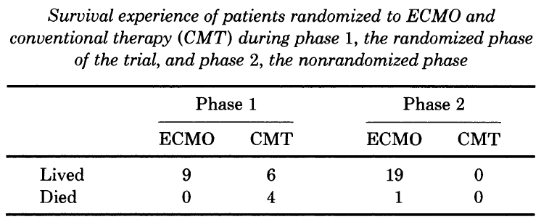
Follow-up Trial
Phase 1, patients are equally randomized into ECMO or CMT until total of 4 deaths are observed in one of the arm.
Switch to Phase 2. All patients are assigned to the other arm until 4 deaths are observed or at least 28 patients are treated.
The trial has a 5%, 1-sided type I error and 77% power under H_{o}: P₁ = P₂ = 0.2 vs. H₁: P₁ = 0.2, P₂ = 0.8
Data showed that the lower end of the 95% CI for P₂ – P₁ = 0.131
Ware, Statistical Science, 1989

Slide 12
Simple Adaptive Randomization (AR)
Consider two treatments, binary outcome
First n pts equally randomized (ER) into TX1 and TX2
After ER phase, the next patient will be assigned to TX1 with probability , where
Note that the tuning parameter
  λ = 0, ER
  λ = 0.5 or 1 or n/(2N)
  λ = ∞, “play the winner”
Continue the study until reaching early stopping criteria or maximum N
Notes:
12

Slide 13
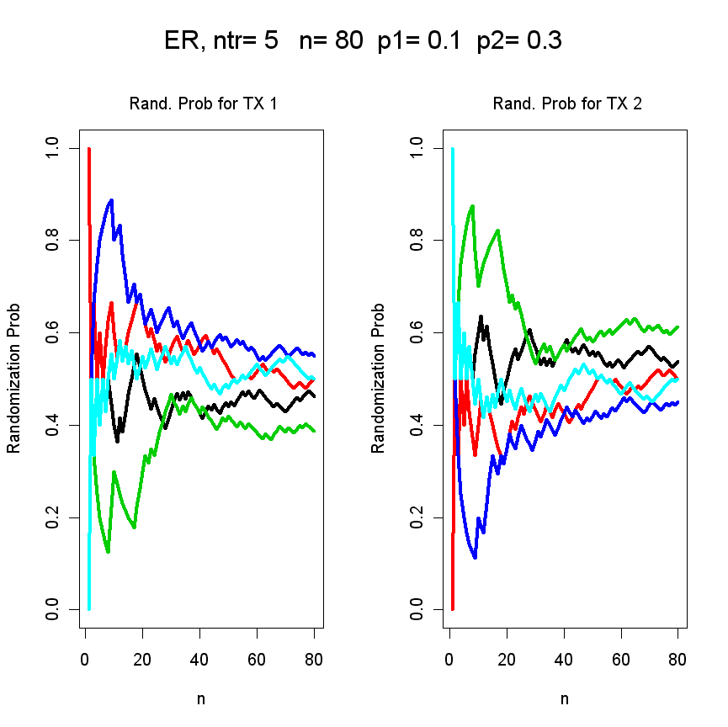
Notes:
13

Slide 14
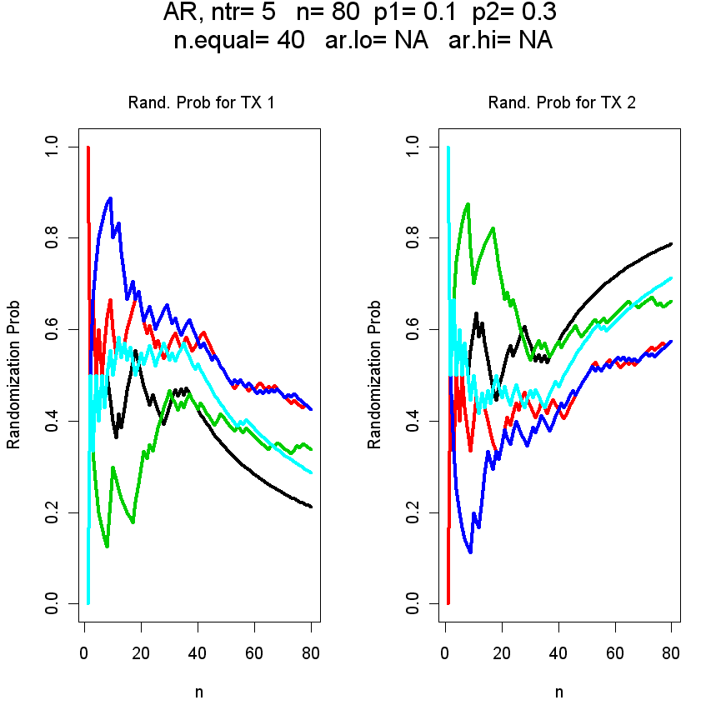
AR rate to TX 1=
Notes:
14

Slide 15
Example 2: Randomized Two-Arm Trial
Frequentist’s approach
  H_{o}: P₁ = P₂ vs. H₁: P₁ < P₂
  P₁ = 0.3, P₂ = 0.5, α=.025 (one-sided), 1−β = .8
  N₁ = N₂ = 103, N = 206
Bayesian approach with adaptive randomization
  Consider P₁ and P₂ are random; Give a prior distribution; Compute the posterior distribution after observing outcomes
  Randomize more patients proportionally into the arm with higher response rate
  At the end of trial,
    Prob(P₁ > P₂) > 0.975, conclude Tx 1 is better
    Prob(P₂ > P₁) > 0.975, conclude Tx 2 is better
  At interim,
    Prob(P₁ > P₂) > 0.999, Stop the trial early, conclude Tx 1 is better
    Prob(P₂ > P₁) > 0.999, Stop the trial early, conclude Tx 2 is better
Notes:
15

Slide 16
AR Comparisons
Use the AR program from http://biostatistics.mdanderson.org/SoftwareDownload/
 | No AR |  | AR |  | AR w/ Early Stopping
 | H_{o} | H₁ | H_{o} | H₁ | H_{o} | H₁
N₁ | 100 | 100
N₂ | 100 | 100
N | 200 | 200
P(Tx1 Better) | .02 | 0
P(Tx2 Better) | .03 | .83
P(Early Stopping)
P(rand. in arm 2) | .50 | .50
Notes:
16

Slide 17
AR Comparisons (2)
 | No AR |  | AR |  | AR w/ Early Stopping
 | H_{o} | H₁ | H_{o} | H₁ | H_{o} | H₁
N₁ | 100 | 100 | 100 | 46
N₂ | 100 | 100 | 100 | 154
N | 200 | 200 | 200 | 200
P(Tx1 Better) | .02 | 0 | .04 | 0
P(Tx2 Better) | .03 | .83 | .04 | .75
P(Early Stopping)
P(rand. in arm 2) | .50 | .50 | .50 | .77
Notes:
17

Slide 18
AR Comparisons (3)
 | No AR |  | AR |  | AR w/Early Stopping, N_{max}=200
 | H_{o} | H₁ | H_{o} | H₁ | H_{o} | H₁
N₁ | 100 | 100 | 100 | 46 | 98 | 42
N₂ | 100 | 100 | 100 | 154 | 97 | 125
N | 200 | 200 | 200 | 200 | 195 | 167
P(Tx1 Better) | .02 | 0 | .04 | 0 | .05 | 0
P(Tx2 Better) | .03 | .83 | .04 | .75 | .05 | .76
P(Early Stopping) |  |  |  |  | .04 | .34
P(rand. in arm 2) | .50 | .50 | .50 | .77 | .50 | .75
Notes:
18

Slide 19
AR Comparisons (4)
 | No AR |  | AR |  | AR w/ Early Stopping (N_{max}=200) |  | AR w/ Early Stopping (N_{max}=250)
 | H_{o} | H₁ | H_{o} | H₁ | H_{o} | H₁ | H_{o} | H₁
N₁ | 100 | 100 | 100 | 46 | 98 | 42 | 122 | 46
N₂ | 100 | 100 | 100 | 154 | 97 | 125 | 121 | 150
N | 200 | 200 | 200 | 200 | 195 | 167 | 243 | 196
P(Tx1 Better) | .02 | 0 | .04 | 0 | .05 | 0 | .05 | 0
P(Tx2 Better) | .03 | .83 | .04 | .75 | .05 | .76 | .05 | .85
P(Early Stopping) |  |  | .04 | .34 | .04 | .34 | .04 | .44
P(rand. in arm 2) | .50 | .50 | .50 | .77 | .50 | .75 | .50 | .77
Overall Resp. | .30 | .40 | .30 | .45 | .30 | .45 | .30 | .45
Notes:
19

Slide 20
ER versus AR
ER is consistent with the equipoise principle which justifies randomization in clinical trials.
In the case of H₀: p₁ = p₂ vs. H₁: p₁ < p₂
  Suppose the true p₁=0.2, p₂=0.4
  We need N=134 to achieve α=0.1, 1- β = 0.9
  If you were patient number 130 in the trial, do you want to be equally randomized?
AR tilts the randomization ratio with the goal of treating patients better during the trial but still controls type I and type II errors.
  Pay a price: N increase to achieve the same power
How to choose the allocation ratio for AR?
  True p₁ and p₂ are unknown, let the data guide us.
What criteria to use to compare the methods?

Slide 21
Optimal Allocation Ratio for AR into Arm 2
Frequentist designs
  Neyman allocation: maximize power
  RSIHR allocation: minimize expected treatment failure for a fixed asymptotic variance
  Rosenberger et al. (Biometrics, 2001), Hu and Rosenberger (JASA 2003)
Bayesian designs
  Robust Bayes approach via backward induction
  maximize total number of successes in patient horizon
    Berry and Eick (SIM 1995)
  r-design
    Cheng and Berry (Biometrika 2007)

Slide 22
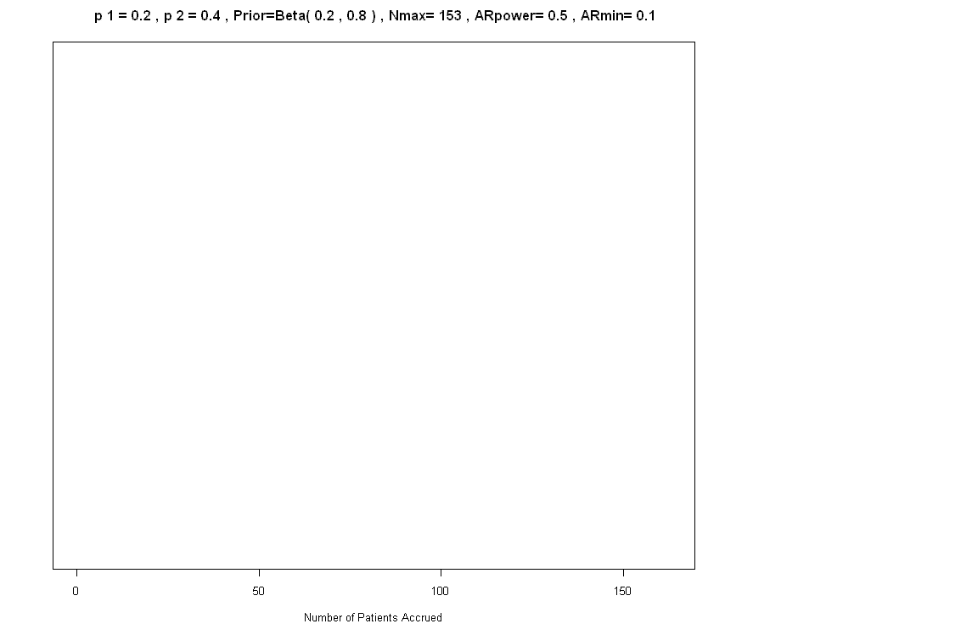
Demo 1

Slide 23
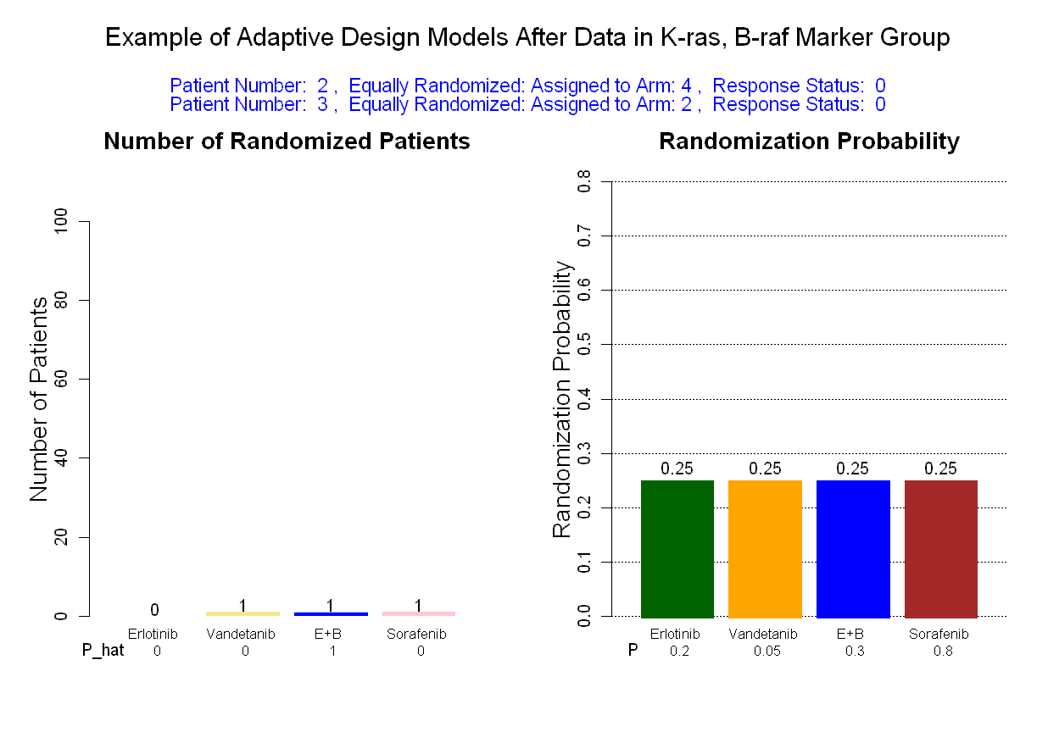
Demo 2

Slide 24
Mechanism of Randomization
Worst: Investigator performs randomization
  Toss a coin
Best: A central, independent, randomization center
  Baseline imbalance
    14% in 57 studies randomization unknown to PI
    26.7% in 55 studies randomization was known to PI
    58% in 43 non-randomized studies
Sequenced and sealed envelopes on site
Telephone randomization
Random assignment list kept in pharmacy
Web-based computer randomization

Slide 25
Study Blindness
Bias can invalidate the study findings.
Bias can be caused by conscious or subconscious factors.
The general solution is to keep the participants and investigators blinded or masked to the assigned intervention.
Blindness helps the uniformity in trial conduct, e.g.: in giving concomitant and compensatory treatment.
It will also help in the objective assessment of response variables.

Slide 26
Fundamental Point
A clinical trial should, ideally, have a double-blind design to avoid potential problems in bias during data collection and assessment.
In studies where such a design is impossible, a single-blind approach and other measures to reduce potential bias are favored.

Slide 27
Type of Trials
Unblinded trials
  E.g.: surgical trials, lifestyle change
  Advantage: easier to design and conduct, less expensive
  Disadvantage: subject to a host of bias, which can be difficult to measure or correct
    Vitamin C trial: Unequal drop-out; drop-in; Influence the treatment course and outcome assessment
    By-pass surgery vs. medication: equal baseline smoking status, more quitter in surgery arm in the trial → confounding
Single-blinded trials
  Only the investigators are aware of the tx assignment.
  Same problems as unblinded trials but maybe to a lesser extent.

Slide 28
Double-blinded trials
  Reduce the risk of bias
  Placebo effect
    In assessing toxicity (e.g.: run-in) and efficacy
  Great efforts needed to manufacture placebo with matched size, shape, color, sheen, odor, taste, etc. Can be expensive to make.
  Special considerations are needed for drug labeling and distribution.
  Periodically checking or sampling the drug content may be necessary.
  Lab test such as checking the serum level may be helpful in monitoring the trial conduct. The results have to be kept confidential though.

Slide 29
The Use of Placebo
Reduce the placebo effect.
Matching placebo is required for each active agent. For example, in a 2x2 factorial design, every participant takes 2 kinds of pills.
Can be cumbersome with large number of active drugs.
  With active drugs A, B, C and placebo D, can make D in three kinds. Each one matched with one active drugs.
May not be possible of the route (p.o./IV) or the pattern of administration (q.d., b.i.d., t.i.d., q.i.d.) is different.

Slide 30
Unblinding Occurred in Trials
Characteristic side effects
  e.g.: beta-carotene (yellowing skin)
  9cRA (headache)
Participants comparing drugs in the waiting room
Participants try to find out
Oversight in labeling, lab testing
Adverse drug reaction (ADR)
  Patient’s safety

Slide 31
Triple-blinded trials
Pts, investigators, and DMC are all blinded.
DMC’s ability of monitoring safety and efficacy can be hampered by being blinded to the tx assignment. The design can be counterproductive.
Improvement: DMC is blinded first but code can be broken per request.

Slide 32
Homework #3 (due Feb 2)
(10 points, 2 point/question)
Assume T₁ and T₂ are the test statistics for Test 1 and Test 2. The relative efficiency of Test 2 vs. Test 1 is defined as
RE = Var(T₁)/Var(T₂)
Suppose two-sample z-test (known variance) is used to compare the outcome of two treatment groups with a total sample size of 100. Let π₁ be the proportion of patients allocated to Arm 1.
Under the assumption of equal variance of 1, plot Var(T| π₁) vs. π₁ for π₁ = 0.1 to 0.9.
Let π₁* be the optimal allocation for assigning patients to Arm 1 which yields the smallest variance for the test statistics. Find π₁*.
Plot RE of π₁ vs. π₁* (on the y-axis) against π₁ (on the x-axis) for π₁ = 0.1 to 0.9.
What is the loss of efficiency for 1:2, 1:3, and 1:4 randomization.
Find out the optimal allocation rule π₁* in the case of unequal variance. Assume the variance of treatments 1 and 2 are σ₁² and σ₂², respectively.

Slide 33
Homework #4 (due Feb 2)
(10 points, Please attach the computer code.)
For testing equal proportion in the two-sample case, using the normal distribution to approximate the binomial distribution.
Please write down the model, the null and alternative hypotheses, the test statistics, and the asymptotic distribution of the test statistics.
Let π₁ be the proportion of patients allocated to Arm 1. Please find π₁* which is the optimal allocation to yield the highest power (or the smallest variance for the test statistics), i.e., the Neyman allocation.
Please derive the RSIHR allocation.
Draw the Neyman allocation and RSIHR allocation versus the probability of success in Arm 1 (p₁) for p₁ between 0 to 1.
Please comment on the above plot regarding the relative merit of the two allocation methods.

