Slide 1
Topics in Clinical Trials (5) - 2012
J. Jack Lee, Ph.D.
Department of Biostatistics
University of Texas
M. D. Anderson Cancer Center

Slide 2
Objectives of Phase II Trials
Initial assessment of drug’s efficacy (IIA)
Refine drug’s toxicity profile
Compare efficacy among active agents and send the most promising one(s) to Phase III trials (IIB)

Slide 3
Key Elements of Phase II Trials
Patient Population
  More homogeneous group with specific disease site, histology, and stage
Dose Level
  At MTD or RPTD from Phase I trials
  Dose adjustment may be needed
Endpoints
  Short term efficacy endpoint
    Response categories: CR, PR, NC, PD at, say, 4 wks
    Response rate: proportion in CR + PR
    Disease control rate: proportion in CR + PR + SD
    (for targeted agents)
    Disease-free survival or progression-free survival

Slide 4
Available Phase II Designs
Phase IIA Trials
  Gehan’s design (J. Chron. Dis. 1961)
  Simon’s two-stage designs (Contr. Clin. Trials, 1989)
  Other multi-stage designs
  Predictive probability design
Phase IIB Trials
  Simon et al.’s ranking and selection randomized phase II design (Cancer Treat. Rep. 1985)
  Thall and Simon’s Bayesian phase IIB design (Biometrics, 1994)

Slide 5
Phase IIA Trials
Let the probability of response be p
H₀: p ≤ p₀
H₁: p ≥ p₁
  p₀ -- an uninteresting response rate
    response rate from a standard treatment
  p₁ -- a desired response rate
    target response rate
Control type I and II error rates
  Type I error: false positive rate
  Type II error: false negative rate

Slide 6
Hypothesis Testing
Framework of hypothesis testing
Truth
Η_{ο} Η₁
α: Type I error
(level of significance)
β: Type II error
(1- β = Power)
Η_{ο}
Η₁
✓
β
Action
α
✓
Sample Size Calculation: Find N s.t. to α and β are under control.
Typically, compute N for a given α to yield (1-β)x100% power.
For example, compute N for α = 0.05 to yield 80% power.

Slide 7
Power
α

Slide 8
P value

Slide 9
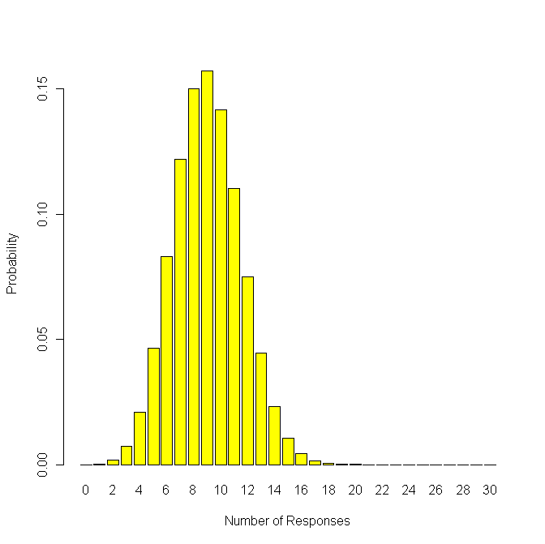
Phase IIA Example
For the binary data (response or no response), the number of response follows a binomial distribution.
Under H_{o}: P=0.30, with N=30 observations

Slide 10
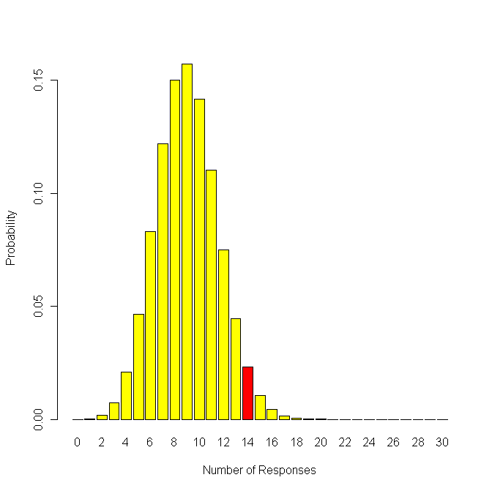
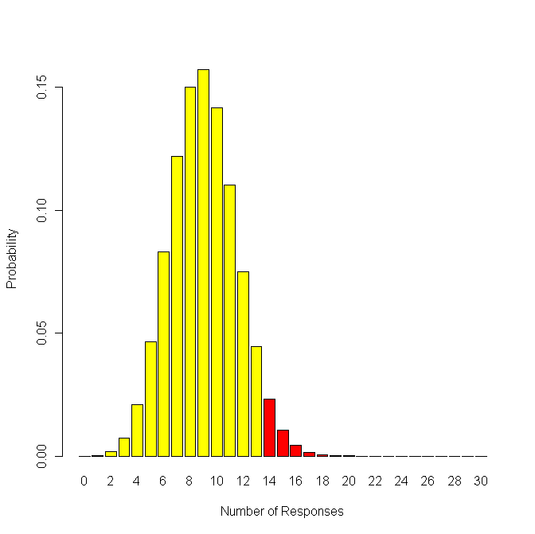
Under H₀ : 14 responses out of 30 pts
# of response 14 15 16 17 18 19
prob. 0.023 0.011 0.004 0.001 0 0
P value = 0.040, Two-sided 95% CI: (0.28, 0.66)

Slide 11
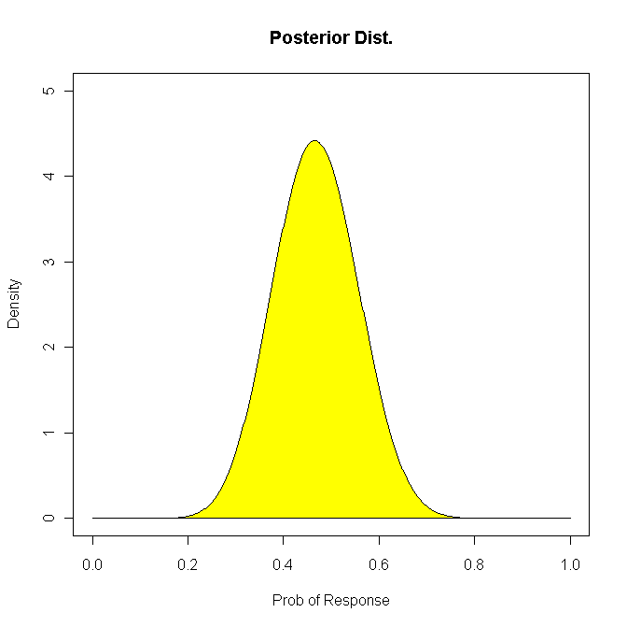
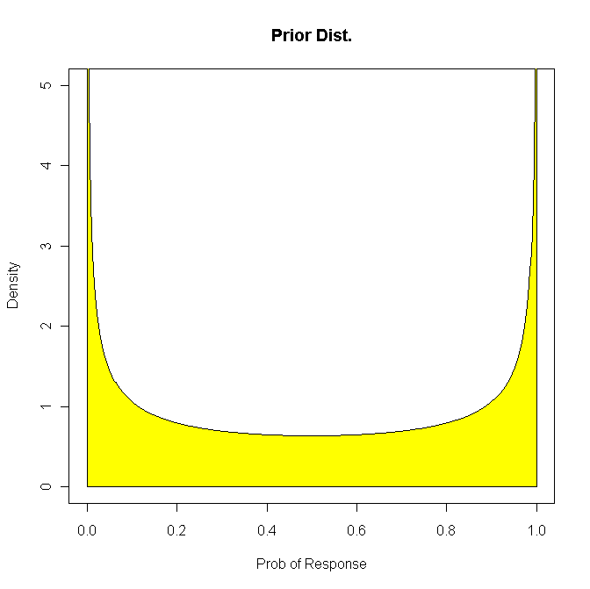
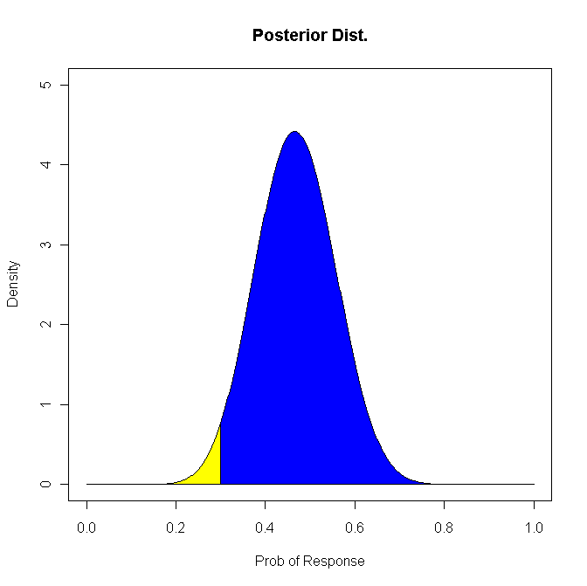
Bayesian Analysis
Prior Distribution: Prob(Resp.) ~ Beta(0.5, 0.5)
Data: 14 out of 30 responded
Posterior Distribution: Prob(Resp.) ~ Beta(14.5, 16.5)
Likelihood(p₀)=0.023, Likelihood(p₁)=0.135, Bayes Factor=0.17
95% highest probability interval: (0.30, 0.63)
P(Resp. Rate > 0.3) = 0.974

Slide 12
Gehan’s Design
Assume p₀ = 0 and p₁ > 0
A two-stage design
  First stage: Enroll n₁ patients, if no one responds to treatment, Reject H₁, quit
  Second stage: If there is at least one response, enroll n₂ patients to refine the estimate of the response rate
What is the type I error rate?
How to choose type II error rate?
  Small β (10% or less) is preferred
    Don’t want to reject promising drugs

Slide 13
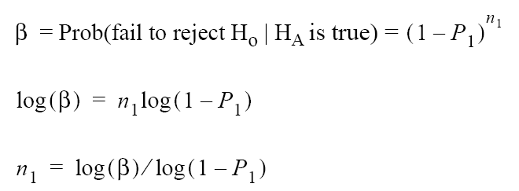
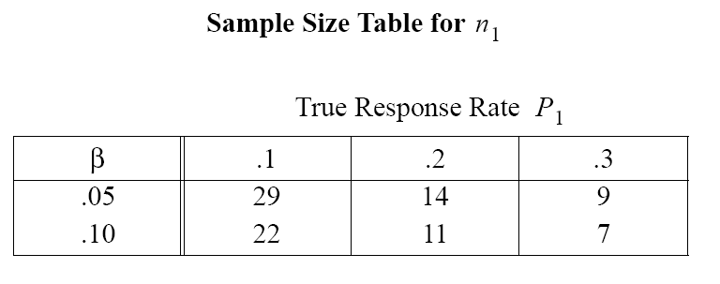
Sample size calculation for Gehan’s design
Stage 1

Slide 14
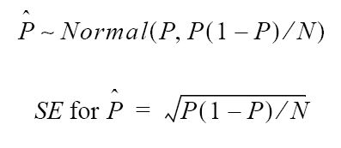
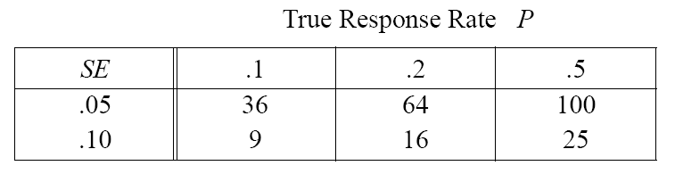
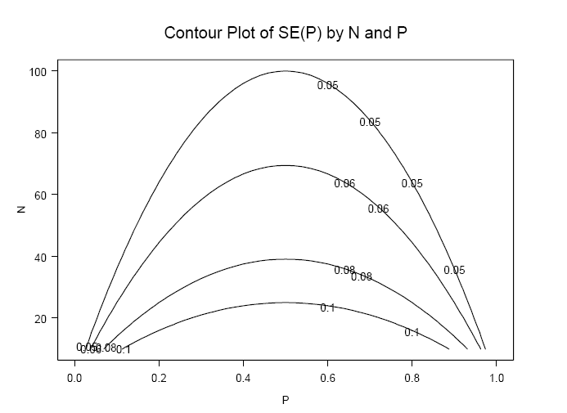
Stage 2

Slide 15
Simon’s Optimal 2-Stage Design
Assume p₀ > 0 and p₁ = p₀ + δ
  Typically, δ = 0.15 to 0.25
A two-stage design
  First stage: Enroll n₁ patients, if r₁ or less respond, Reject H₁, quit
  Second stage: If there is at least r₁ + 1 responses, enroll n₂ more patients
  Final decision: If total number of responses is r or less, reject H₁. Otherwise, reject H₀
Two types of design
  Optimal: minimize the expected N under H₀
  Minimax Design: minimize the maximum N

Slide 16
Simon’s Optimal 2-Stage Design
H₀: p ≤ p₀
H₁: p ≥ p₁
p₀=0.10, p₁=0.25, α = β = 0.10
n
Rejection Region
in # of Responses
E(N | p₀) = 31.2
PET(p₀) = 0.65
21
0 ~ 2
50
3 ~ 7
Notes:
In phase II cancer clinical trials, one of the focuses is on testing if a new treatment regimen has a promising response rate that warrants further investigation.
In this single arm hypothesis testing setting, p0 is an uninteresting response rate and p1 is a desired target response rate.

Slide 17
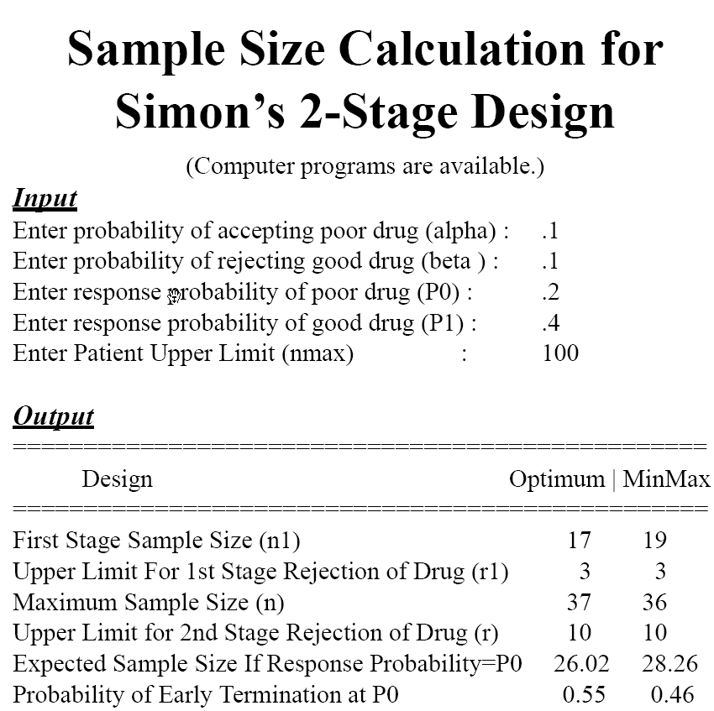

Slide 18
Comments on Simon’s Design
Suitable for p₀ > 0
Allow stopping early due to futility: Good
Does not allow stopping early due to initial efficacy: Good
Drawback:
  No early stopping when a long string of failures are observed
  Similar to all frequentist designs, when the conduct deviates from the design, all statistical properties no longer hold

Slide 19

Prediction Is Hard, Especially About The Future.

Slide 20
Simon’s Minimax/Optimal 2-Stage Design
Stage 1: Enroll n₁ patients,
If ≤ r₁ responses, stop trial, reject H₁;
Otherwise continue to Stage 2;
Stage 2: Enroll N_{max} - n₁ patients,
If ≤ r responses, reject H₁
PET(p₀) = Prob(Early Termination | p₀) = pbinom(r₁, n₁ , p₀)
E(N |p₀) = n₁ + [1 - PET(p₀)] × (N_{max} - n₁)
Minimax Design: Smallest N_{max}
Optimal Design: Smallest E(N|p₀)
Notes:
Simon’s Solution:
Simon’s 2-stage designs have n1 patients tested first.
If r1 or less responses are seen, the treatment will be abandoned.
Otherwise, the trial will continue to the second stage. If r or less responses, reject H₁. Otherwise, the treatment is considered as being promising and warrants further investigation.
The design is optimal when the expected sample size under null hypothesis is the smallest among all designs that satisfy the constraint of type I and type II errors.

Slide 21
Example
p₀=0.20, p₁=0.40, α = β = 0.10
Simon’s MiniMax 2-Stage Design
n
Rejection Region
in # of Responses
α = 0.086
β = 0.098
E(N | p₀) = 28.26
PET(p₀) = 0.46
19
0 ~ 3
36
4 ~ 10
Simon’s Optimal 2-Stage Design
n
Rejection Region
in # of Responses
α = 0.095
β = 0.097
E(N | p₀) = 26.02
PET(p₀) = 0.55
17
0 ~ 3
37
4 ~ 10
Notes:
21

Slide 22
Predictive Probability
Design Setting:
p₀=0.20, p₁=0.40
Prior for p = Beta(0.2, 0.8)
N₁=10, N_{max} =36 (search 27 ~ 42)
Cohort size=1 (continuously monitoring)
Constraints:
    α = 0.1, β = 0.1
Goal:
  Find θ_{L} , θ_{T} , and N_{max} to satisfy the constraints
Lee JJ and Liu DD. A predictive probability design for phase II cancer clinical trials. Clinical Trials 5:93-106, 2008
Notes:
22

Slide 23
Bayesian Approach
Prior distribution of response rate:
p ~ beta(a₀, b₀)
f₀(p)=Γ(a₀ + b₀)/[Γ(a₀)×Γ(b₀)] × p^{a0-1} × (1-p) ^{b0-1}
Enroll n patients (maximum accrual=N_{max})
Observed responses X ~ bin(n, p)
Likelihood function: L_{x}(p) ∝ p^{x} × (1-p)^{n-x}
Posterior distribution:
beta(a₀ + x, b₀+ n − x)
f(p|x) = f₀(p) × L_{x}(p) ∝ p ^{a0} ^{+ x – 1} × (1-p) ^{b0} ^{+ n – x −1}
Notes:
In Bayesian approach, we can assume a prior distribution of response rate to be a beta distribution.
We enroll n patients, if number of responses follows a binomial distribution, we have the likelihood function.
From the prior and likelihood function, we get the posterior distribution for response rate. It is a beta distribution again.

Slide 24
Predictive Probability (PP) Design
PP is the probability of rejecting H₀ at the end of study should the current trend continue,
i.e., given the current data, the chance of declaring a “positive” result at the end of study.
If PP is very large or very small, essentially we know the answer → can stop the trial now and draw a conclusion.
# of future patients: m=N_{max} − n
# of future responses: Y ~ beta-binomial(m, a₀ + x, b₀ + n − x)
For each Y=i: f(p|x, Y=i)= beta(a₀ + x + i, b₀ + N_{max} − x − i)
Notes:
Given maximum accrual of Nmax patients, number of potential future patients is m, number of future responses in m patients Y has a beta-binomial distribution. For each observation of Y, posterior distribution of response rate p is again a beta distribution.

Slide 25
Reject H₀
Y=i Prob(Y=i | x) B_{i}=P[p>p₀|p ~ f(p|x,Y=i), x, Y=i] I_{i}(B_{i} > θ_{T})
0 Prob(Y=0 | x) B₀= B₀(Y=0) 0
1 Prob(Y=1 | x) B₁= B₁(Y=1) 0
… … … …
m-1 Prob(Y=m-1| x) B_{m-1}= B_{m-1}(Y=m-1) 1
m Prob(Y=m | x) B_{m}= B_{m}(Y=m) 1
Predictive Probability (PP)
= ∑ {Prob(Y=i | x) ×
[Prob(p > p₀ | p ~ f(p|x,Y=i) , x, Y=i) > θ_{T} ]}
= ∑ [Prob(Y=i | x) × I_{i}(B_{i} > θ_{T})]
Notes:
Based on this setting, we have the following table. We can calculate the probability of y=i, and probability of response rate greater than p0 (Bi) given Y. Comparing Bi to a threshold value pT (to give us I) basically tells us if the treatment is promising at current data and given Y.
If we sum I over all possible Y’s, we obtain the predictive probability of seeing a promising result at the end of the trial based on current data.

Slide 26
PP Decision Rule
At Each Stage,
If PP = ∑ [Prob(Y=i | x) × I_{i}(B_{i} > θ_{T})] < θ_{L} , Stop Trial, accept H₀
Otherwise, Continue to the Next Stage until N_{max}
Goal: Find θ_{L} , θ_{T} , and N_{max} to satisfying the
constraint of type I and type II error rates
(NOTE: In a phase IIA trial, we typically don’t want to stop early due to efficacy; can treat more patients and learn more about the treatment’s efficacy and toxicity.)
Notes:
The decision rule is:
at the end of each stage of the trial,
If this quantity is less than a small number pL, which means it is unlikely the response rate will be larger than p0, we may as well stop the trial at this point and reject the alternative hypothesis
Otherwise, Continue to the next stage until Nmax
So, based on this setting,
Given p0, prior, n, Nmax, pL, pT:
(1) Stopping boundary can be determined.
(2) Type I and Type II errors can be calculated.

Slide 27
Predictive Probability
  Searching Process
α
N_{max} =36
θ_{L} = 0.001
θ_{T} = 0.852 ~ 0.922
θ_{T}
θ_{L}
Notes:
27

Slide 28
Power
N_{max} =36
θ_{L} = 0.001
θ_{T} = 0.852 ~ 0.922
θ_{L}
θ_{T}
Notes:
28

Slide 29
Operating characteristics of designs with type I and type II error rates ≤ 0.10, prior for p = beta(0.2,0.8), p₀=0.2, p₁=0.4
Simon’s Minimax/Optimal 2-Satge
 | r1/n1 | r/N_{max} | PET(p₀) | E(N| p₀) | α | β
Minimax | 3/19 | 10/36 | 0.46 | 28.26 | 0.086 | 0.098
Optimal | 3/17 | 10/37 | 0.55 | 26.02 | 0.095 | 0.097
Predictive Probability
θ_{L} | θ_{T} | r/N_{max} | PET(p₀) | E(N| p₀) | α | β
--- | --- | na/35⁺ | --- | --- | 0.126 | 0.093
--- | --- | na/35⁺⁺ | --- | --- | 0.074 | 0.116
0.001 | [0.852,0.922]* | 10/36 | 0.86 | 27.67 | 0.088 | 0.094
0.011 | [0.830,0.908] | 10/37 | 0.85 | 25.13 | 0.099 | 0.084
0.001 | [0.876,0.935] | 11/39 | 0.88 | 29.24 | 0.073 | 0.092
0.001 | [0.857,0.923] | 11/40 | 0.86 | 30.23 | 0.086 | 0.075
0.003 | [0.837,0.910] | 11/41 | 0.85 | 30.27 | 0.100 | 0.062
0.043 | [0.816,0.895] | 11/42 | 0.86 | 23.56 | 0.099 | 0.083
0.001 | [0.880,0.935] | 12/43 | 0.88 | 32.13 | 0.072 | 0.074
0.001 | [0.862,0.924] | 12/44 | 0.87 | 33.71 | 0.085 | 0.059
0.001 | [0.844,0.912] | 12/45 | 0.85 | 34.69 | 0.098 | 0.048
0.032 | [0.824,0.898] | 12/46 | 0.86 | 26.22 | 0.098 | 0.068
0.001 | [0.884,0.936] | 13/47 | 0.89 | 35.25 | 0.071 | 0.058
0.001 | [0.868,0.925] | 13/48 | 0.87 | 36.43 | 0.083 | 0.047
0.001 | [0.850,0.914] | 13/49 | 0.86 | 37.86 | 0.095 | 0.038
0.020 | [0.832,0.901] | 13/50 | 0.86 | 30.60 | 0.100 | 0.046

Slide 30
Stopping Boundaries for p₀=0.20, p₁=0.40, α= β= 0.10
 | Simon’s Optimal |  | PP
n | Rej Region | PET(p₀) | Rej Region | PET(p₀)
10 |  |  | 0 | 0.1074
17 | 3 | 0.55 | 1 | 0.0563
21 |  |  | 2 | 0.0663
24 |  |  | 3 | 0.0815
27 |  |  | 4 | 0.0843
29 |  |  | 5 | 0.1010
31 |  |  | 6 | 0.0996
33 |  |  | 7 | 0.0895
34 |  |  | 8 | 0.0946
35 |  |  | 9 | 0.0767
36 | 10 | 0.55 | 10 | 0.86
prior for
p = beta(0.2,0.8)
α = 0.088
= 0.094
E(N | p₀) = 27.67
PET(p₀) = 0.86
Simon’s MiniMax:
α = 0.086
β = 0.098
E(N | p₀) = 28.26
PET(p₀) = 0.46
Simon’s Optimal:
α = 0.095
β = 0.097
E(N | p₀) = 26.02
PET(p₀) = 0.55
Notes:
30

Slide 31
PP Boundaries by varying the prior for p
 | prior(p)
 | beta(0.2,0.8) |  | beta(2, 8) |  | beta(4, 6)
Rej in # of Resp. | n | PET(p₀) | n | PET(p₀) | n | PET(p₀)
0 | 10 | 0.1074 | 14 | 0.0440 | 18 | 0.0180
1 | 17 | 0.0563 | 18 | 0.0631 | 21 | 0.0415
2 | 21 | 0.0663 | 21 | 0.0847 | 23 | 0.0764
3 | 24 | 0.0815 | 24 | 0.0925 | 26 | 0.0823
4 | 27 | 0.0843 | 27 | 0.0916 | 28 | 0.1064
5 | 29 | 0.1010 | 29 | 0.1073 | 30 | 0.1131
6 | 31 | 0.0996 | 31 | 0.1042 | 32 | 0.1088
7 | 33 | 0.0895 | 33 | 0.0927 | 33 | 0.1219
8 | 34 | 0.0946 | 34 | 0.0972 | 34 | 0.1054
9 | 35 | 0.0767 | 35 | 0.0783 | 35 | 0.0807
10 | 36 | 0.0551 | 36 | 0.0560 | 36 | 0.0567
α = 0.088, β = 0.094
E(N|p₀)=27.7, PET(p₀) = 0.86
α = 0.089, β = 0.091
E(N|p₀)=28.9, PET(p₀) = 0.86
α = 0.089, β = 0.091
E(N|p₀)=30.6, PET(p₀) = 0.85
Notes:
31

Slide 37
for Different Priors

Slide 38
for Different Priors

Slide 39
Case 1: 1st stage: 0 of 10 responses,
N_{max}=36, prior of p=beta(0.2, 0.8), θ_{L}=0.001, θ_{T} =0.900
Y=i | P(Y=i | x) | B_{i}=P(p>20% | x, Y=i) | I_{i}(B_{i}>0.9) | Y=i | P(Y=i | x) | B_{i}=P(p>20% | x, Y=i) | I_{i}(B_{i}>0.90)
0 | 0.7784 | 0.0000 | 0 | 14 | 0.0001 | 0.9942 | 1
1 | 0.1131 | 0.0006 | 0 | 15 | 0.0000 | 0.9980 | 1
2 | 0.0487 | 0.0047 | 0 | 16 | 0.0000 | 0.9994 | 1
3 | 0.0254 | 0.0209 | 0 | 17 | 0.0000 | 0.9998 | 1
4 | 0.0142 | 0.0637 | 0 | 18 | 0.0000 | 1.0000 | 1
5 | 0.0083 | 0.1473 | 0 | 19 | 0.0000 | 1.0000 | 1
6 | 0.0049 | 0.2751 | 0 | 20 | 0.0000 | 1.0000 | 1
7 | 0.0029 | 0.4338 | 0 | 21 | 0.0000 | 1.0000 | 1
8 | 0.0017 | 0.5980 | 0 | 22 | 0.0000 | 1.0000 | 1
9 | 0.0010 | 0.7422 | 0 | 23 | 0.0000 | 1.0000 | 1
10 | 0.0006 | 0.8511 | 0 | 24 | 0.0000 | 1.0000 | 1
11 | 0.0003 | 0.9227 | 1 | 25 | 0.0000 | 1.0000 | 1
12 | 0.0002 | 0.9639 | 1 | 26 | 0.0000 | 1.0000 | 1
13 | 0.0001 | 0.9848 | 1
Will you stop the trial?
PP=0.0008 < θ_{L} , Stop the trial

Slide 40
Case 1

Slide 41
Case 1
0/10 responses
PP=0.0008 < θ_{L} , Stop the trial

Slide 42
Case 1
0/10 responses
STOP
Declare H₀
Prob(p > 0.2) = 0.0086

Slide 43
Case 2: 1st stage: 2 of 10 responses,
N_{max}=36, prior of p=beta(0.2, 0.8), θ_{L}=0.001, θ_{T} =0.900
Y=i | P(Y=i | x) | B_{i}=P(p>20% | x, Y=i) | I_{i}(B_{i}>0.90) | Y=i | P(Y=i | x) | B_{i}=P(p>20% | x, Y=i) | I_{i}(B_{i}>0.90)
0 | 0.0539 | 0.0047 | 0 | 14 | 0.0098 | 0.9994 | 1
1 | 0.0912 | 0.0209 | 0 | 15 | 0.0064 | 0.9998 | 1
2 | 0.1112 | 0.0637 | 0 | 16 | 0.0040 | 1.0000 | 1
3 | 0.1175 | 0.1473 | 0 | 17 | 0.0024 | 1.0000 | 1
4 | 0.1141 | 0.2751 | 0 | 18 | 0.0014 | 1.0000 | 1
5 | 0.1044 | 0.4338 | 0 | 19 | 0.0007 | 1.0000 | 1
6 | 0.0914 | 0.5980 | 0 | 20 | 0.0004 | 1.0000 | 1
7 | 0.0770 | 0.7422 | 0 | 21 | 0.0002 | 1.0000 | 1
8 | 0.0628 | 0.8511 | 0 | 22 | 0.0001 | 1.0000 | 1
9 | 0.0496 | 0.9227 | 1 | 23 | 0.0000 | 1.0000 | 1
10 | 0.0381 | 0.9639 | 1 | 24 | 0.0000 | 1.0000 | 1
11 | 0.0284 | 0.9848 | 1 | 25 | 0.0000 | 1.0000 | 1
12 | 0.0206 | 0.9942 | 1 | 26 | 0.0000 | 1.0000 | 1
13 | 0.0144 | 0.9980 | 1
Will you stop the trial?
PP=0.1766 > θ_{L} , Continue the trial

Slide 44
Case 2: 1st stage: 2 of 10 responses, followed by 0 out of 12 patients responses
N_{max}=36, prior of p=beta(0.2, 0.8), θ_{L}=0.001, θ_{T} =0.900
Y=i | P(Y=i | x) | B_{i}=P(p>20% | x, Y=i) | I_{i}(B_{i}>0.90) | Y=i | P(Y=i | x) | B_{i}=P(p>20% | x, Y=i) | I_{i}(B_{i}>0.90)
0 | 0.3303 | 0.0047 | 0 | 8 | 0.0007 | 0.8511 | 0
1 | 0.3010 | 0.0209 | 0 | 9 | 0.0002 | 0.9227 | 1
2 | 0.1909 | 0.0637 | 0 | 10 | 0.0000 | 0.9639 | 1
3 | 0.1008 | 0.1473 | 0 | 11 | 0.0000 | 0.9848 | 1
4 | 0.0468 | 0.2751 | 0 | 12 | 0.0000 | 0.9942 | 1
5 | 0.0195 | 0.4338 | 0 | 13 | 0.0000 | 0.9980 | 1
6 | 0.0073 | 0.5980 | 0 | 14 | 0.0000 | 0.9994 | 1
7 | 0.0025 | 0.7422 | 0
Will you stop the trial?
PP= 0.0002 < θ_{L} , Stop the trial

Slide 45
Case 2

Slide 46
Case 2
2/10 responses
PP=0.1766 > θ_{L}
GO

Slide 47
Case 2

Slide 48
Case 2
0/12 responses
PP=0.0002 < θ_{L}, Stop the trial

Slide 49
Case 2
Prior Dist=Beta(2.2, 8.8)
Posterior Dist=Beta(2.2, 20.8)
8
8
Prob(p > 0.2) = 0.063
6
6
STOP
Density
4
Density
4
Declare H₀
2
2
Prob(p>0.2)=0.063
0
0
0.0
0.2
0.4
0.6
0.8
1.0
0.0
0.2
0.4
0.6
0.8
1.0
Prob of Response
Prob of Response

Slide 50
Case 3
2/10 responses
GO

Slide 51
Case 3
4/12 responses
GO

Slide 52
Case 3
5/14 responses

Slide 53
Case 3: At the end of study with N=36
Prob(p > 0.2) = 0.92
> θ_{T}=0.9
Declare H₁

Slide 54
Summary for the PP Method
PP design can control type I and type II error rates by choosing appropriate θ_{L} , θ_{T} , and , N_{max}.
Under H₀, PP design can yield a higher PET(p₀), and smaller E(N|p₀) or N_{max} than Simon’s 2-stage design
PP design produces a flexible monitoring schedule with robust operating characteristics across a wide range of stages and cohort sizes.
Advantages of PP design compared to standard multi-stage design
    More flexible
    More efficient
    More robust
Notes:
Predictive probability method provides an excellent alternative for
designing and monitoring multi-stage Phase II trials. The design is
efficient and flexible.
a. Type I and type II error rates can be controlled by choosing appropriate pL and pT.
b. Under H0, PP design yields a higher PET(p0), and smaller
E(N|p0) than Simon’s optimal 2-stage design.
c. PP method produces flexible monitoring schedule with robust
operating characteristics across a wide range of stages and
cohort sizes.

Slide 55
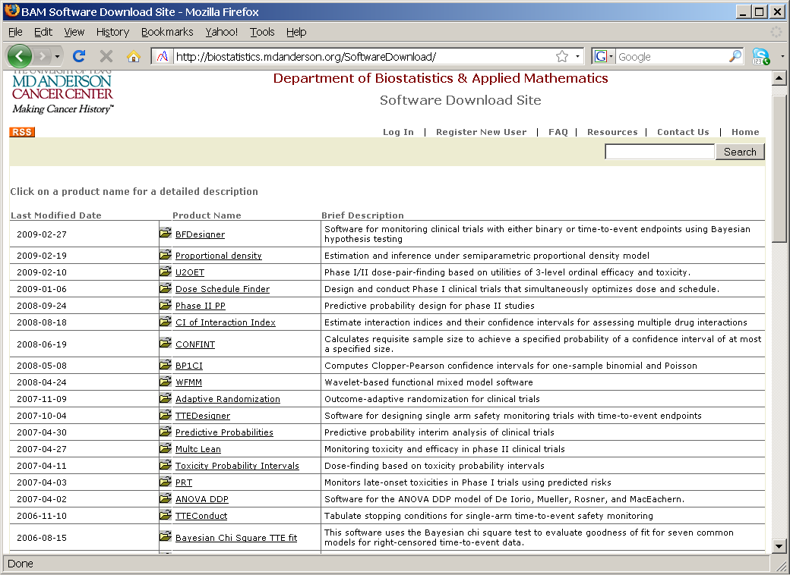
http://biostatistics.mdanderson.org/SoftwareDownload
A Windows executable version is also available.

Slide 56
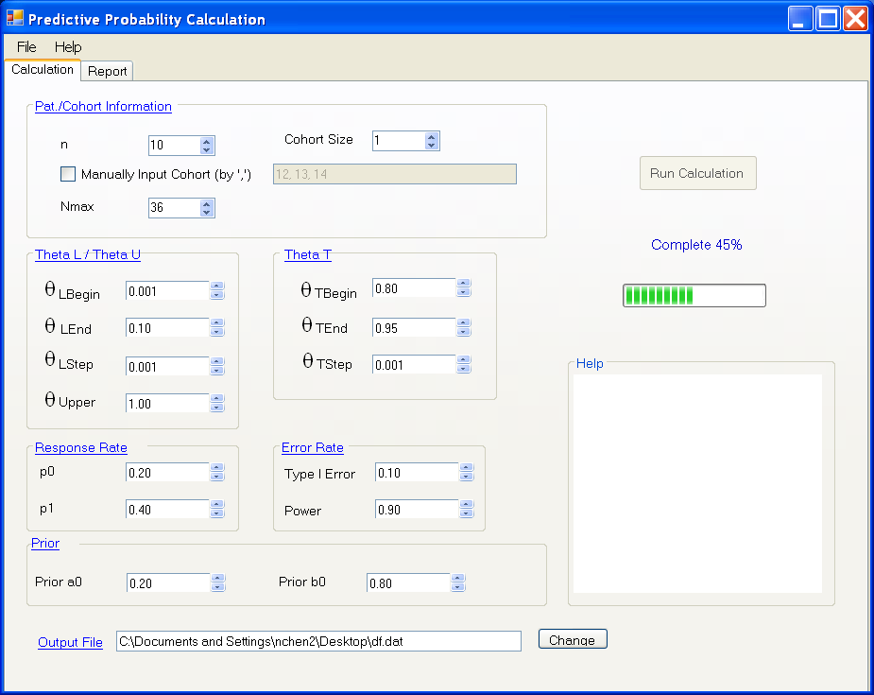

Slide 57
Output
Input Data
=======================
10 n
1 Cohort
36 Nmax
0.0010 theta_Lbegin
0.1000 theta_Lend
0.0010 theta_Lstep
0.8000 theta_Tbegin
0.9500 theta_Tend
0.0010 theta_Tstep
0.2000 p_0
0.4000 p_1
0.2000 Prior a0
0.8000 Prior b0
1.0000 thetaUpper
0.1000 Type I Error
0.9000 Power
Calculation Result
=======================
theta_L and theta_T ranges:
theta_L 0.0010 0.0010
theta_T 0.8520 0.9220
Rejection Reg. PET/(p0)
10 0 0.1074
11 0 0.0000
12 0 0.0000
13 0 0.0000
14 0 0.0000
15 0 0.0000
16 0 0.0000
17 1 0.0563
18 1 0.0000
19 1 0.0000
20 1 0.0000
21 2 0.0663
22 2 0.0000
23 2 0.0000
24 3 0.0815
25 3 0.0000
26 3 0.0000
27 4 0.0843
28 4 0.0000
29 5 0.1010
30 5 0.0000
31 6 0.0996
32 6 0.0000
33 7 0.0895
34 8 0.0946
35 9 0.0767
36 10 0.0000
PET(p0) 0.8571
E(N|p0) 27.6677
Alpha 0.0878
Beta 0.0938

Slide 58
Phase I and Phase II Trials
Most Phase I trials are single-arm, open label studies.
Most Phase IIA trials are also single-arm, open label studies.
Phase IIB trials can be
  Single-arm trials compared to results from historical controls.
  Multi-arm randomized Phase II trials
    Each arm is designed as a Phase IIA study. The purpose of randomization is to achieve patient compatibility across arms.
    Applying the “ranking and selection” design.
    “Mini Phase III” trials with
      higher type I error rate (e.g., 10% or even 20%)
      earlier endpoint: progression-free survival instead of overall survival
      larger difference to be detected

Slide 59
SWE’s Randomized Phase II Design
Simon, Wittes, Ellenberg (Cancer Tr. Reports, 1985)
Goal : Among several promising agents, choose the best one to send to Phase III
Design :
  Randomly assign equal number of pts to each tx
  Choose the one yields the best result for phase III
Sample size per group for correctly selecting “best” tx with 90% power when the response rate is 15% better than the smallest response rate
    Number of Treatments
Smallest Response Rate 2 3 4____
.10 21 31 37
.20 29 44 52
.30 35 52 62

Slide 60
Pick the Winner Selection Design
Simon, Wittes, Ellenberg (Cancer Tr. Reports, 1985)
Goal : Among several promising agents, choose the best one to send to Phase III
Design :
  Randomly assign equal number of pts to each tx
  Choose the one yields the best result for phase III
Sample size per group for correctly selecting “best” tx with 90% power when the response rate is 15% better than the smallest response rate
    Number of Treatments
Smallest Response Rate 2 3 4____
.10 21 31 37
.20 29 44 52
.30 35 52 62
2-arm Phase III Trial α = 0.05
146
197
230

Slide 61
Properties of the Pick the Winner Design
A pick the winner design based on the ranking and selection procedure
  Randomize pts across all arms. At the end of study, pick the arm with best outcome and declare the “winner.”
Compared to comparative randomized trials, the required sample size is much smaller
  For example, for a two-arm trials with P₁ = 0.10, P₂ = 0.25, α=.05 (two-sided), 1−β = .9, N₁ = N₂ = 146.
  Using the SWE design, N₁ = N₂ = 21.
Is it too good to be true?
What is the catch?

Slide 62
Under H_{a} , Picking any “o” as the winner is considered making a “correct selection”
Response Rate
o
}
o
o
}
o
}
δ
δ
δ
x
x
x
x
x
(1)
(2)
(3)
When the response rate of the best treatment(s) is at least δ better than the next better ones, Prob(correctly selecting “o”) is minimized under (1)
Scenario (1) is called the least favorable condition.

Slide 63
However, under H_{o} , there is no penalty in picking any treatment as the winner
Response Rate
}
}
o
o
}
δ
o
o
o
δ
o
δ
o
o
o
(4)
(5)
(6)
The design has no protection of type I error rate.
It only protects from choosing the inferior treatments if they are at least δ worse than the better one(s).

Slide 64
Limitation of the Pick the Winner Design
SWE design dose not impose a penalty for choosing any winners within the P₂ − P₁ = δ range, e.g., if
P₂ = 0.40 and P₁ = 0.30. For δ = 0.15 choosing either Arm 1 or Arm 2 as the “winner” is considered OK.
Type I error rate can be inflated from 20% to over 40%.
(Liu et al. Contr Clin Trials, 1999)
A poor man’s phase III design?
  No. For ranking and selection design, no comparative tests should be performed (low power).
Another drawback of the design is: no early stopping due to futility or efficacy.
It works when all treatments are active. The probability of selecting a treatment which is much worse than others is low. (It controls β error.)

Slide 65
Randomized Discontinuation Design
Tumor shrinkage ≥25%
(n=73)
Continue open-label sorafenib
(n=79)
Placebo*
12 weeks
(n=33)
18% Progression free 24 weeks
Sorafenib
12-week run-in
(n=202)
Tumor growth/ shrinkage <25%
(n=69)
Sorafenib
12 weeks
(n=32)
50% Progression free 24 weeks
Tumor growth ≥25%
(n=51†)
Off study
(n=58)
P = 0.0077
Disease status at
12 weeks unknown
(n=9)
*Placebo patients who progressed could cross over to sorafenib
†Including 36 patients without bidimensional tumor measurements, but with radiological evidence of progression
Ratain et al, JCO, 2006; Rosner et al, JCO 2002.

Slide 66
Randomized Discontinuation vs.
Standard Randomized Designs
Randomized Discontinuation Design
  Advantage
    Select a more homogeneous study population, hence, provide smaller bias without pre-specified markers
    All patients are treated with new treatment up front
  Disadvantage
    Loss (considerable) power in most settings
    Ethical concerns to stop “effective” tx.
Standard Randomized Design should be used with more carefully selected eligibility criteria
Reference
  Parcey et al., Investigational New Drugs 2011
  Stadler et al. Journal of Clinical Oncology, 2005
  Capra WB. Comparing the power of the discontinuation design to that of the classic randomized design on time-to-event endpoints. Controlled Clinical Trials 25: 168–177, 2004

Slide 67
Homework #6 (due 2/16)
Sample size calculation for testing a binomial probability in one sample
In a Phase IIA trial, the goal is to test whether a new drug has anti-tumor activities in a single-arm, open label study. Assume the probability of response is p, we are interested in testing the following hypothesis:
H₀: p ≤ p₀
H₁: p ≥ p₁
Suppose in stage IIIB non-small cell lung cancer (NSCLC), the standard therapy has a response rate of 0.3. A new targeted therapy is being evaluated.
1. Calculate the sample size required for testing a target response of 0.5 with a 10% type I error rate and 90% power in a one-stage design. (You may use STPLAN from http://biostatistics.mdanderson.org/SoftwareDownload/.)
2. Under the same assumptions, calculate the sample size required using the Simon’s optimal and minimax two-stage design. (You may use PII87.exe)
3. Using the R function “ksb1prob.R” to verify alpha, beta, early stopping probabilities, and averaged sample number for k-stage binomial design given stopping boundaries (The program is based on a recursive formula given by Schultz et al, Biometrics, 1973.)
4. Write your own R program to calculate the sample size for the Simon’s optimal and minimax two-stage design using the recursive formula and exhaustive search.
5. Under the same assumptions in, calculate the sample size required using the predictive probability design. (Reference: Lee JJ, Liu DD. A predictive probability design for phase II cancer clinical trials. Clin Trials 5(2):93-106, 2008.) Please provide the stopping boundaries.
6. Compare the results of the three designs in questions 1, 2, and 5 above.

