Slide 1
Topics in Clinical Trials (7) - 2012
J. Jack Lee, Ph.D.
Department of Biostatistics
University of Texas
M. D. Anderson Cancer Center

Slide 2
Multiple Significance Testings
Interim analysis
Subgroup analysis
Multiple endpoints
Silent multiplicity
Implications
Why not look at everything in the data?
Hypothesis testing versus hypothesis generating
Overall type I error rate should be controlled for confirmatory studies
Type I error rate (alpha) may be allocated across many comparisons
Requires prioritizing comparisons and should be done a priori.

Slide 3
Why Need Interim Analysis?
Many trials require large N and/or long duration.
Interim analysis can result in more efficient designs s.t. correct conclusion can be reached sooner.
Ethical considerations
Pace of scientific advancement demands learning from the current observed data Otherwise, results may be obsolete or irrelevant by the end of study
Public health concerns, pressure from activists
Requirement from IRB and other regulatory agencies

Slide 4
Factors to Consider before Early Termination
Possible difference in prognostic factors among arms
Bias in assessing response variables
Impact of missing data
Differential concomitant tx or adherence
Differential side effects
Secondary outcomes
Internal consistency
External consistency, other trials

Slide 5
To Stop or Not To Stop?
How sure?
Is the evidence strong enough or just due to stochastic variation or imbalance in covariates or other factors?
Wrongly stopping for efficacy: false positive
False claim that the drug is active
Waste time and money for future development
Wrongly stopping for futility: false negative
Kill a promising drug
Group ethics vs. individual ethics

Slide 6
Friedman et al. 1998

Slide 7
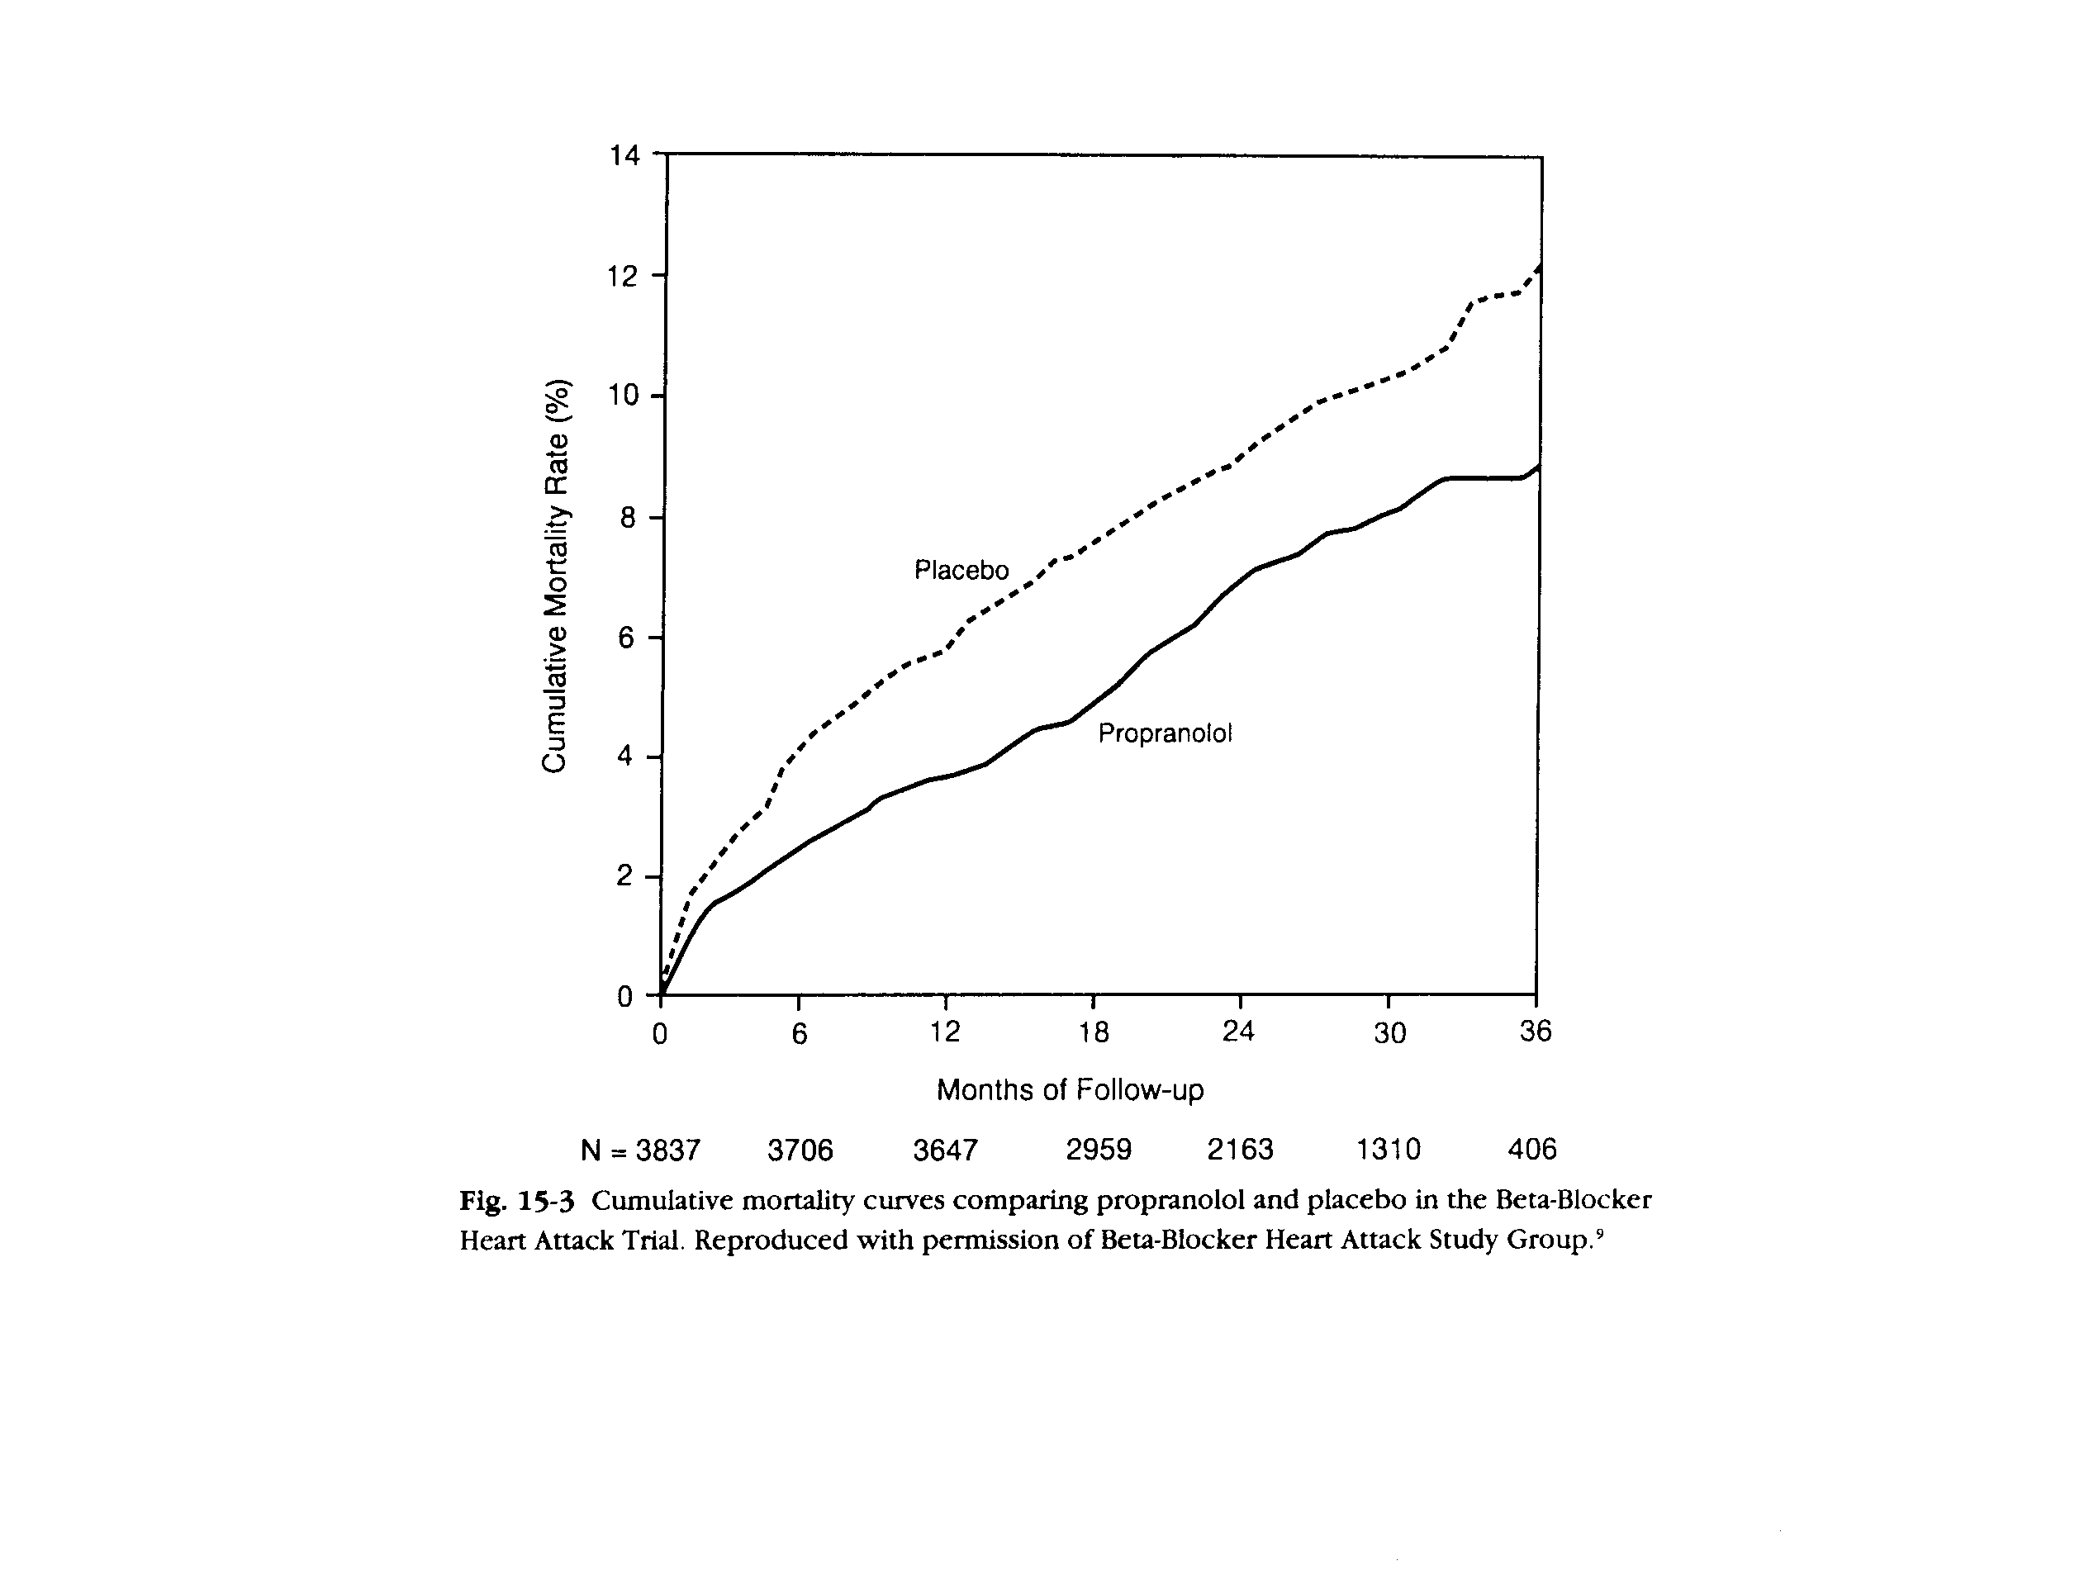

Slide 8
Repeated Significance Testing
Suppose there are K tests: K-1 interim analyses and one final analysis.
Perform each test at α level.
If 1st test H_{o} is rejected, stop the trial and declare the drug is efficacious.
If not, continue the trial until the time of 2nd test.
If 2nd test H_{o} is rejected, stop the trial and declare the drug is efficacious.
If not, continue the trial, …
Until the final analysis. If H_{o} is rejected, declare the drug is efficacious. Otherwise, declare the drug is inefficacious
The more tests, the more likely that H_{o} can be rejected
What is the overall significance level?

Slide 9
Okay, Okay,
whatever you say!
If you torture the data hard enough, it will confess to anything.

Slide 10
Repeated Significance Test for Independent Data
K | Bonferroni | Prob( ≥ 1 significant)
1 | .05 | 0.050
2 | .10 | 0.098
3 | .15 | 0.143
4 | .20 | 0.185
5 | .25 | 0.226
6 | .30 | 0.265
7 | .35 | 0.302
8 | .40 | 0.337
9 | .45 | 0.370
10 | .50 | 0.401
One test at α level
K tests, each at α level
What is Prob(sig) ?
Bonferroni Bound
Prob(sig) = K α
Independent test
Prob(sig) = 1 – (1-p)^{K}

Slide 11
Repeated Significance Test for Correlated Data
 | Independent |  | Correlated
K | Bonferroni | Prob( ≥ 1 significant) | Prob( ≥ 1 significant)
1 | .05 | 0.050 | 0.05
2 | .10 | 0.098 | 0.08
3 | .15 | 0.143 | 0.11
4 | .20 | 0.185 | 0.13
5 | .25 | 0.226 | 0.14
10 | .50 | 0.401 | 0.19
20 | 1.00 | 0.642 | 0.25
50 | 1.00 | 0.923 | 0.32
100 | 1.00 | 0.994 | 0.37
1000 | 1.00 | 1.000 | 0.53
∞ | 1.00 | 1.000 | 1.00

Slide 12
Repeated Significance Testing

Slide 13
Repeated Significance Testing (cont.)
Armitage et al. (1969) developed a recursive numerical integration algorithm to evaluate p_{k}(α).
For α∗=0.05 and K=71, a=2.84, which corresponds to a nominal significance level of α=0.005 = α∗ /10.

Slide 14
Fully Sequential Trial
Originally developed by Wald.
Evaluate the result after each outcome is observed. Then, make decision to continue or stop the trial.
Not feasible for clinical outcomes. Usually the result is not instantaneous.
Logically prohibitive in clinical setting where subject accrual and outcome evaluation both take time.
Cumbersome to monitor the study outcome frequently, especially for large trials involve hundreds or thousands or subjects.
Open plan: Without pre-specified sample size or timeframe, it makes the planning difficult.

Slide 15
Group Sequential Test
Example: Two-sample Z test with known variance

Slide 16
Group Sequential Test (cont.)
For group sequential test, subjects are entered in groups.
Choose a maximum number of groups, K
Set a group size, m, for each arm
For each k = 1, …, K, a standardized test statistics Z_{k} is computed from the first k groups of observations
Starting from k = 1, if |Z_{k}| ≥c_{k} , reject H_{o} and stop the trial.
Otherwise continue the trial until k = K
if |Z_{K}| ≥c_{K} , reject H_{o}; otherwise, accept H_{o}

Slide 17
Goals of the Group Sequential Trials
Choose the critical values {c₁ ,c₂ ,…,c_{K}} to preserve the overall α rate.
It is desirable to stop the trial early if there is a treatment difference.
It is desirable to minimize the expected sample size under both H_{o} and H₁
In the standard GST, no early stopping for futility

Slide 18
Distribution of the Test Statistics

Slide 19
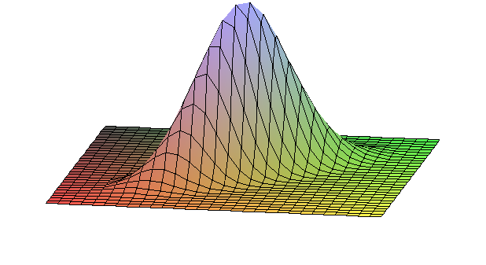
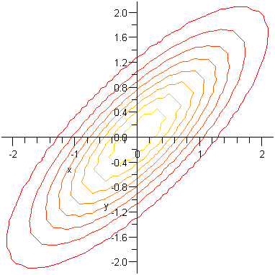
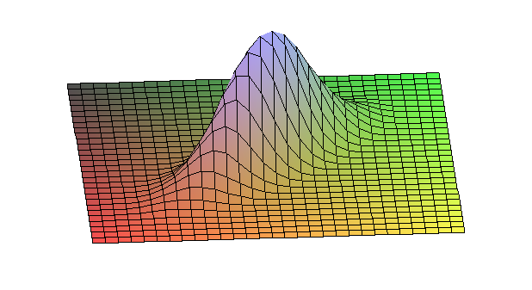

Slide 20
Generalization of Group Sequential Test
In addition to entering 2m pts in K groups, as long as the joint distribution of the test statistics (Z₁, Z₂, …, Z_{K}) is known, the stopping boundaries can be computed.
GST can be applied to typical clinical trial settings where pts are accrued and outcomes are observed over time.
GST can be applied to binary outcomes & survival endpoints.
The same asymptotic distribution for the test statistics holds if equal amount of information (e.g. number of events for survival endpoints) is obtaining in each interim analysis.
Accrual
Follow-up
0 1 2 3 4 5 6 7
analysis

Slide 21
Commonly Used Boundaries

Slide 22
Critical Values
# of groups | Ana-lysis | Pocock |  | O’Brien-Flemming |  | Peto
 |  | Z | P | Z | P | Z | P
2 | 1 | 2.178 | .029 | 2.797 | .005 | 3.290 | .001
 | 2 | 2.178 | .029 | 1.977 | .048 | 1.962 | .050
3 | 1 | 2.289 | .022 | 3.471 | .0005 | 3.290 | .001
 | 2 | 2.289 | .022 | 2.454 | .014 | 3.290 | .001
 | 3 | 2.289 | .022 | 2.004 | .045 | 1.964 | .050
4 | 1 | 2.361 | .018 | 4.049 | .0001 | 3.290 | .001
 | 2 | 2.361 | .018 | 2.863 | .004 | 3.290 | .001
 | 3 | 2.361 | .018 | 2.338 | .019 | 3.290 | .001
 | 4 | 2.361 | .018 | 2.024 | .043 | 1.967 | .049
5 | 1 | 2.413 | .016 | 4.562 | .00001 | 3.290 | .001
 | 2 | 2.413 | .016 | 3.226 | .0013 | 3.290 | .001
 | 3 | 2.413 | .016 | 2.634 | .008 | 3.290 | .001
 | 4 | 2.413 | .016 | 2.281 | .023 | 3.290 | .001
 | 5 | 2.413 | .016 | 2.040 | .041 | 1.967 | .049

Slide 23
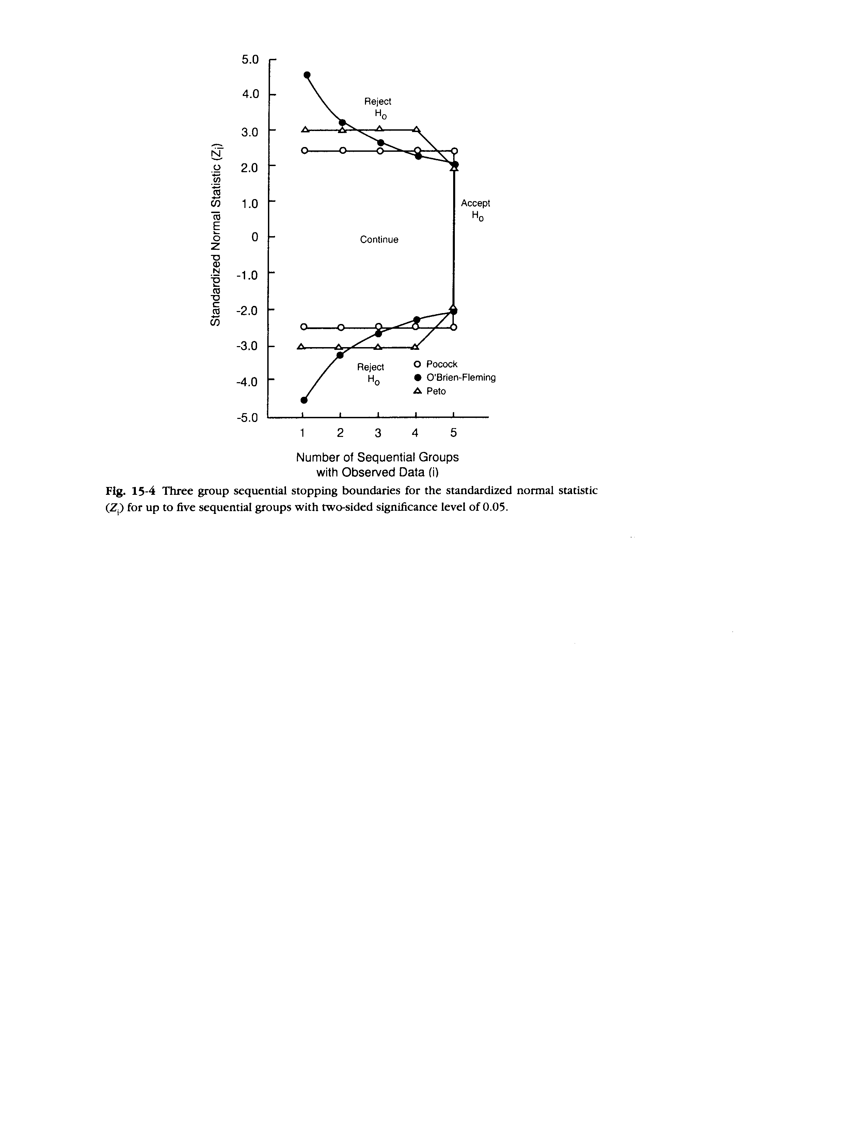

Slide 24
Notes:
One example of using the O’Brien-Fleming boundary to monitor clinical trial can be illustrated in this figure taken from Friedman et al. The x-axis corresponds to the study time. The y-axis shows the Z-value of the test statistics. The upper part of the two sided stopping boundary is shown in the connected curve. The first test was done on May 1979 and the Z value was 1.68. The second test was done on Oct 1979 with a Z value of 2.24. The trial continued until at the 6th test, the Z-value was 2.82 – finally crossed the stopping boudary.
Friedman, Furberg, and DeMets: Fundamentals of Clinical Trials. 3rd ed.: New York: Springer, 1998.

Slide 25
Two-sample Z test (Pocock)

Slide 26
Two-sample Z test (O’Brien-Fleming)

Slide 27
Jennison & Turnbull, 2000

Slide 28
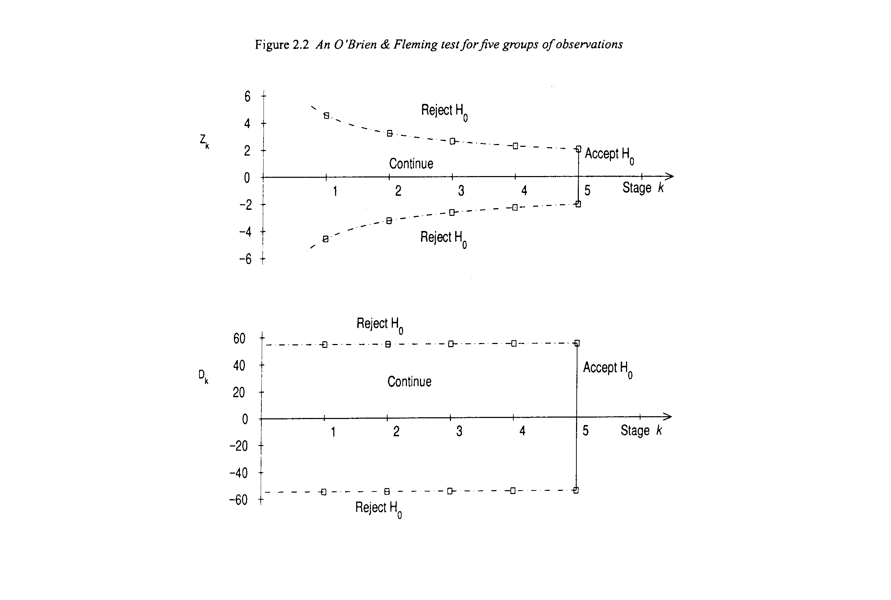
Jennison & Turnbull, 2000

Slide 29
Limitation of Fixed Boundaries
Need to specify # of analysis beforehand
Need to specify when to do analysis
The rigid design limits the possible adjustments required in the middle of the trial
Solution: α − spending function approach (Lan and DeMets)

Slide 30
α − Spending Function
Fixed the total type I error rate α
Flexible design by plotting the cumulative α spending on the y-axis and total information time on the x-axis
After choosing the spending function, it is not required to pre-specify the number of interim analysis or when to do the analysis
The stopping boundaries can be calculated conditioned upon the previous tests

Slide 32
Extensions
Repeated confidence interval (RCI)
Invert the GST
(tx effect) ± Z_{k} (s.e. of the difference)
Asymmetric boundaries
Main purpose of most trials is to show superiority of the new tx
If new tx shows a strong, but non-significant harmful effect, one may wants to stop the trial
Keep the upper stopping boundary but set the lower boundary to an arbitrary value, e.g.
Z_{k} =-1.5 or -2.0
Curtailed sampling procedures

Slide 33
Design Considerations
How many tests needed?
When to do the test?
Too early: waste α
Too late: defeat the purpose of interim analysis
Equal information time
What stopping boundaries to choose?
Optimal boundaries?
Criteria for optimization
e.g. minimize the average sample number (ASN) under both H_{o} and H₁

Slide 34
Homework #9 (due 2/23)
Please show the results with 3 significant digits after the decimal point.
In the group sequential design with K=2 and equal group size, assume the null hypothesis is true in a)-e).
Write down the joint distribution of the standardized test statistics (Z₁, Z₂).
Plot the contour plot of the density function of (Z₁, Z₂).
Choosing the critical region (c₁, c₂) = (1.96, 1.96), compute the tail probabilities (probability of rejecting H_{o}) of the 1st and 2nd tests. What is the overall α? [Hint: use pmvnorm() in S+/R]
To control the overall two-sided type I error rate at 5%,
i) Derive the Pocock boundary (i.e. compute the critical region (c₁, c₂) ).
ii) Derive the O’Brien-Fleming boundary.
iii) Derive the stopping boundaries for the uniform a α-spending function.
e) Give the probability of rejecting H_{o} at the 1st test, the 2nd test, and either test using
i) the Pocock boundary, ii) the O’Brien-Fleming boundary,
iii) the uniform α-spending boundary
Do the same problem as in e) but assume under H_{a} with the mean of (Z₁, Z₂) = (2, 3).
Please contrast the 3 stopping boundaries from the results in e) and f)

Slide 35
Homework #10 (due 2/23)
Suppose you are asked to design a randomized placebo-controlled trial to compare a new anti-hypertensive drug versus placebo. The primary endpoint is blood pressure reduction in a standardized unit (assume a known variance of 1). The goal is to test whether the new drug can reduce blood pressure by 0.4 standard unit (alternative hypothesis) or not.
Use a two-sample Z-test to analyze the data. All the designs will require to have an overall two-sided 5% type I error rate and 80% power. Simulate the designs with 100,000 runs
a) Write down the null and alternative hypotheses.
b) Compute the sample size needed without an interim analysis. (Design A)
c) Simulate the design and compute the empirical power under the null (type I error) and the alternative hypotheses.
d) Give the stopping boundaries when there is one interim analysis in the middle of the trial by using – Design B: Pocock’s method and Design C: O’Brien-Fleming’s method
e) Compute the sample size needed for Designs B and C to achieve 80% power.
f) By simulations, under the null hypothesis, compute (i) average sample number (ASN) at each stage and for the entire trial, (ii) probability of early stopping, and (iii) empirical power for Designs B and C.
g) Repeat f) above but do simulations under the alternative hypothesis
h) Taking the results from above, make a table and compare Designs A, B, and C under the null and alternative hypotheses in terms of
(1) ASN in each stage and total N (2) probability of early stopping (3) empirical power
i) Which design will you choose and why?

